Slide 1
Scalla/xrootd
Andrew Hanushevsky
SLAC National Accelerator Laboratory
Stanford University
19-August-2009
Atlas Tier 2/3 Meeting
http://xrootd.slac.stanford.edu/

Slide 2
Outline
System Component Summary
Recent Developments
Scalability, Stability, & Performance
ATLAS Specific Performance Issues
Faster I/O
The SSD Option
Conclusions

Slide 3
The Components
xrootd
Provides actual data access
cmsd
Glues multiple xrootd’s into a cluster
cnsd
Glues multiple name spaces into one name space
BeStMan
Provides SRM v2+ interface and functions
FUSE
Exports xrootd as a file system for BeStMan
GridFTP
Grid data access either via FUSE or POSIX Preload Library

Slide 4
Recent Developments
File Residency Manager (FRM)
April, 2009
Torrent WAN transfers
May, 2009
Auto-reporting summary monitoring data
June, 2009
Ephemeral files
July, 2009
Simple Server Inventory
August, 2009

Slide 5
File Residency Manager (FRM)
Functional replacement for MPS scripts
Currently, includes…
Pre-staging daemon frm_pstgd and agent frm_pstga
Distributed copy-in prioritized queue of requests
Can copy from any source using any transfer agent
Used to interface to real and virtual MSS’s
frm_admin command
Audit, correct, obtain space information
Space token names, utilization, etc.
Can run on a live system

Slide 6
Torrent WAN Transfers
The xrootd already supports parallel TCP paths
Significant improvement in WAN transfer rate
Specified as xrdcp –S num
New Xtreme copy mode option
Uses multiple data sources bit torrent-style
Specified as xrdcp –x
Transfers to CERN; examples:
1 source (.de): 12MB/sec ( 1 stream)
1 source (.us): 19MB/sec ( 15 streams)
4 sources (3 x .de + .ru): 27MB/sec ( 1 stream each)
4 sources + || streams: 42MB/Sec (15 streams each)
5 sources (3 x .de + .it + .ro): 54MB/Sec (15 streams each)

Slide 7
Summary Monitoring
xrootd has built-in summary monitoring
In addition to full detailed monitoring
Can auto-report summary statistics
xrd.report configuration directive
Data sent to up to two central locations
Accommodates most current monitoring tools
Ganglia, GRIS, Nagios, MonALISA, and perhaps more
Requires external xml-to-monitor data convertor
Can use provided stream multiplexing and xml parsing tool
Outputs simple key-value pairs to feed a monitor script

Slide 8
Ephemeral Files
Files that persist only when successfully closed
Excellent safeguard against leaving partial files
Application, server, or network failures
E.g., GridFTP failures
Server provides grace period after failure
Allows application to complete creating the file
Normal xrootd error recovery protocol
Clients asking for read access are delayed
Clients asking for write access are usually denied
Obviously, original creator is allowed write access
Enabled via xrdcp –P option or ofs.posc CGI element

Slide 9
Simple Server Inventory (SSI)
A central file inventory of each data server
Does not replace PQ2 tools (Neng Xu, Univerity of Wisconsin)
Good for uncomplicated sites needing a server inventory
Inventory normally maintained on each redirector
But, can be centralized on a single server
Automatically recreated when lost
Updated using rolling log files
Effectively no performance impact
Flat text file format
LFN, Mode, Physical partition, Size, Space token
“cns_ssi list” command provides formatted output

Slide 10
Stability & Scalability
xrootd has a 5+ year production history
Numerous high-stress environments
BNL, FZK, IN2P3, INFN, RAL, SLAC
Stability has been vetted
Changes are now very focused
Functionality improvements
Hardware/OS edge effect limitations
Esoteric bugs in low use paths
Scalability is already at the theoretical maximum
E.g., STAR/BNL runs a 400+ server production cluster

Slide 11
Performance I
Following figures are based on actual measurements
These have also been observed by many production sites
E.G., BNL, IN2P3, INFN, FZK, RAL , SLAC
Figures apply only to the reference implementation
Other implementations vary significantly
Castor + xrootd protocol driver
dCache + native xrootd protocol implementation
DPM + xrootd protocol driver + cmsd XMI
HDFS + xrootd protocol driver
CAVEAT!

Slide 12
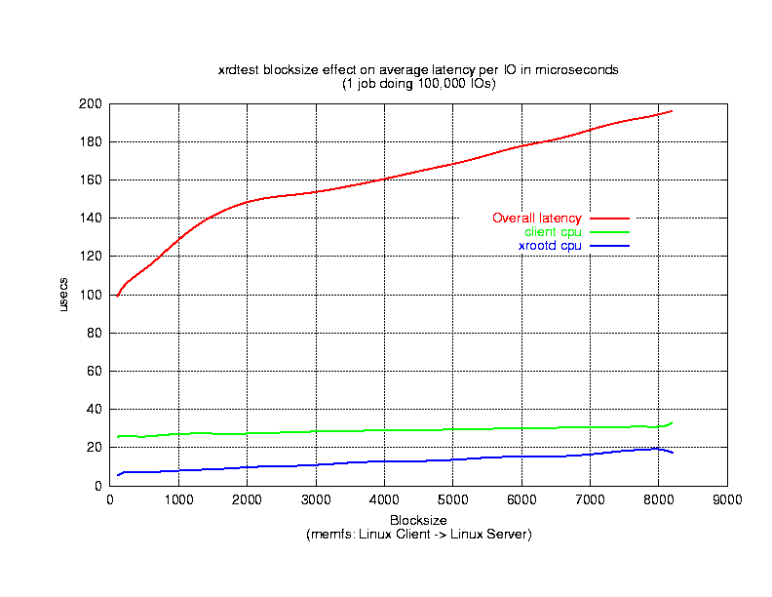
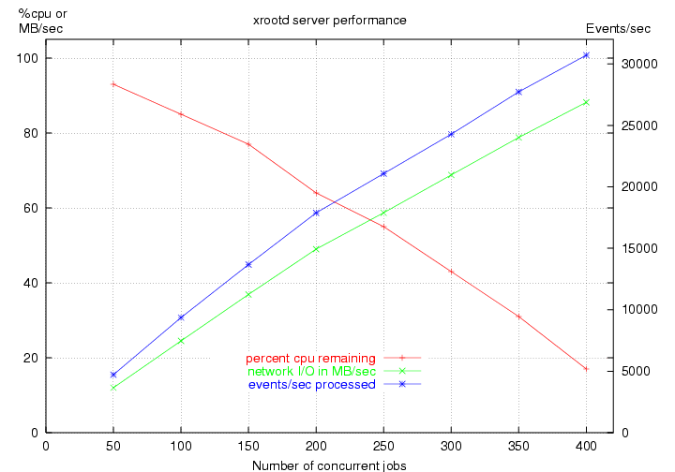
Performance II
Latency
Capacity vs. Load
Sun V20z 1.86 GHz dual Opteron 2GB RAM
1Gb on board Broadcom NIC (same subnet)
Linux RHEL3 2.4.21-2.7.8ELsmp
xrootd latency < 10µs → network or disk latency dominates
Practically, at least ≈10,000 Ops/Second with linear scaling
xrootd+cmsd latency (not shown) 350µs →»1000 opens/second

Slide 13
Performance & Bottlenecks
High performance + linear scaling
Makes client/server software virtually transparent
A 50% faster xrootd yields 3% overall improvement
Disk subsystem and network become determinants
This is actually excellent for planning and funding
Transparency makes other bottlenecks apparent
Hardware, Network, Filesystem, or Application
Requires deft trade-off between CPU & Storage resources
But, bottlenecks usually due to unruly applications
Such as ATLAS analysis
However

Slide 14
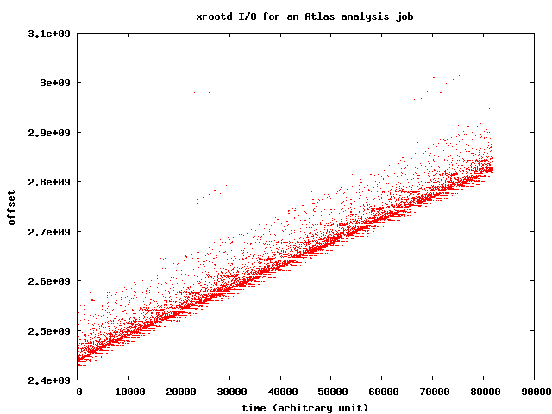
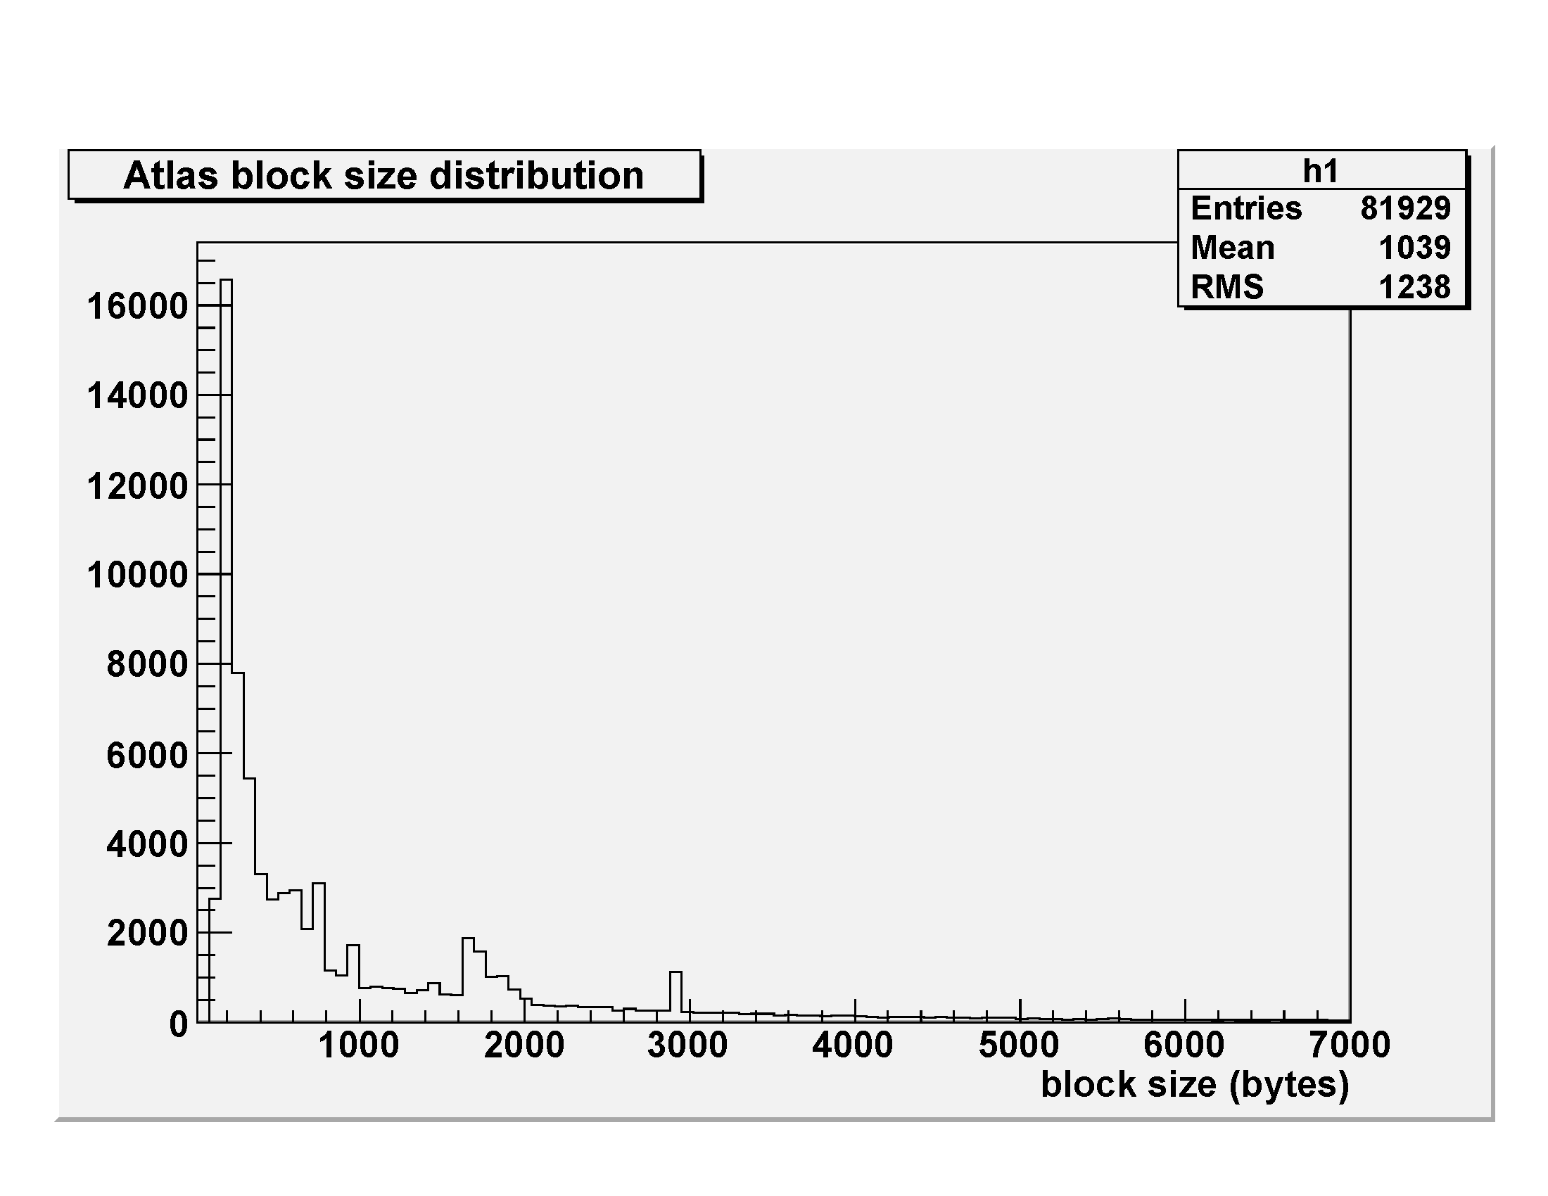
ATLAS Data Access Pattern

Slide 15
ATLAS Data Access Problem
Atlas analysis is fundamentally indulgent
While xrootd can sustain the request load the H/W cannot
Replication?
Except for some files this is not a universal solution
The experiment is already disk space insufficient
Copy files to local node for analysis?
Inefficient, high impact, and may overload the LAN
Job will still run slowly and no better than local disk
Faster hardware (e.g., SSD)?
This appears to be generally cost-prohibitive
That said, we are experimenting with smart SSD handling

Slide 16
Faster Scalla I/O (The SSD Option)
Latency only as good as the hardware (xrootd adds < 10µs latency)
Scalla component architecture fosters experimentation
Research on intelligently using SSD devices
Disk
ZFS Specific
ZFS caches disk blocks
Xrootd I/O:
Data sent from RAM/Flash
Data received sent to Disk
Flash
Disk
R/O Disk File Cache
Flash
FS Agnostic
Xrootd caches files
Xrootd I/O:
Data sent from RAM/Flash
Data received sent to Disk
Xrootd
Xrootd
R/O Disk Block Cache

Slide 17
The ZFS SSD Option
Decided against this option (for now)
Too narrow
OpenSolaris now or Solaris 10 Update 8 (likely 12/09)
Linux support requires ZFS adoption
Licensing issues stand in the way
Current caching algorithm is a bad fit for HEP
Optimized for small SSD’s
Assumes large hot/cold differential
Not the HEP analysis data access profile

Slide 18
The xrootd SSD Option
Currently architecting appropriate solution
Fast track is to use staging infrastructure
Whole files are cached
Hierarchy: SSD, Disk, Real MSS, Virtual MSS
Slower track is more elegant
Parts of files are cached
Can provide parallel mixed mode (SSD/Disk) access
Basic code already present
But needs to be expanded
Will it be effective?

Slide 19
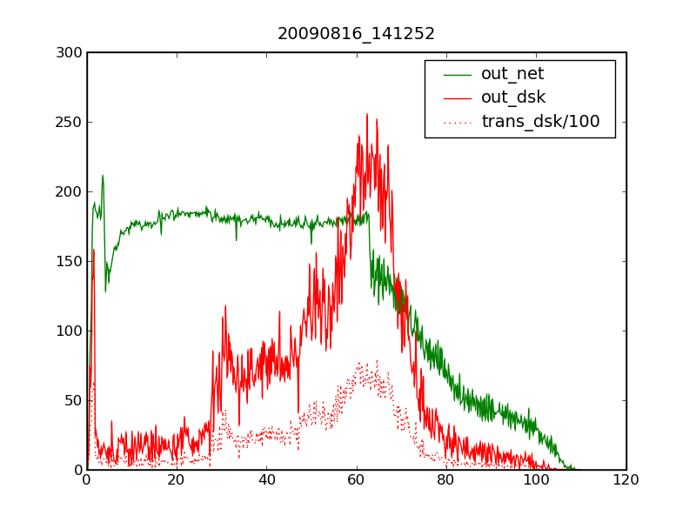
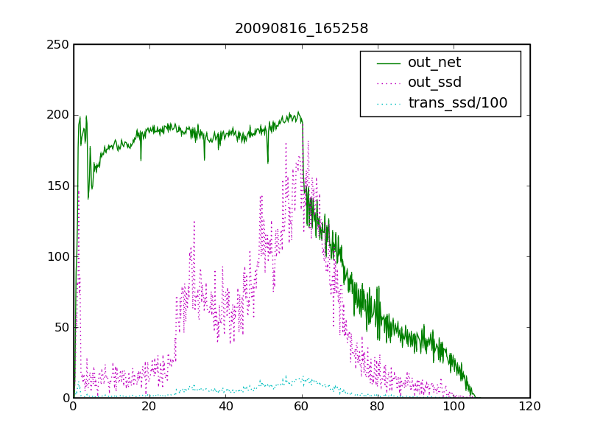
Disk vs SSD With 323 Clients
MB/s
Min
CPU/Net Bottleneck?
CPU/Net Bottleneck?
Disk I/O
SSD I/O

Slide 20
What Does This Mean?
Well tuned disk can equal SSD Performance
True when number of well-behaved clients < small n
Either 343 Fermi/GLAST clients not enough or
Hitting some undiscovered bottleneck
Huh? What about ATLAS clients?
Difficult if not impossible to get
Current grid scheme prevents local tuning & analysis
Desperately need a “send n test jobs” button
We used what we could easily get
Fermi read size about 1K and somewhat CPU intensive

Slide 21
Conclusion
Xrootd is a lightweight data access system
Suitable for resource constrained environments
Human as well as hardware
Rugged enough to scale to large installations
CERN analysis & reconstruction farms
Flexible enough to make good use of new H/W
Smart SSD
Available in OSG VDT & CERN root package
Visit the web site for more information
http://xrootd.slac.stanford.edu/

Slide 22
Acknowledgements
Software Contributors
Alice: Derek Feichtinger
CERN: Fabrizio Furano , Andreas Peters
Fermi/GLAST: Tony Johnson (Java)
Root: Gerri Ganis, Beterand Bellenet, Fons Rademakers
SLAC: Tofigh Azemoon, Jacek Becla, Andrew Hanushevsky, Wilko Kroeger
LBNL: Alex Sim, Junmin Gu, Vijaya Natarajan (BeStMan team)
Operational Collaborators
BNL, CERN, FZK, IN2P3, RAL, SLAC, UVIC, UTA
Partial Funding
US Department of Energy
Contract DE-AC02-76SF00515 with Stanford University

