Slide 1



ATLAS Experiment and GCE
Google IO Conference
San Francisco, CA
May 15-17, 2013
Sergey Panitkin (BNL) and Andrew Hanushevsky (SLAC), for the ATLAS Collaboration

Slide 2
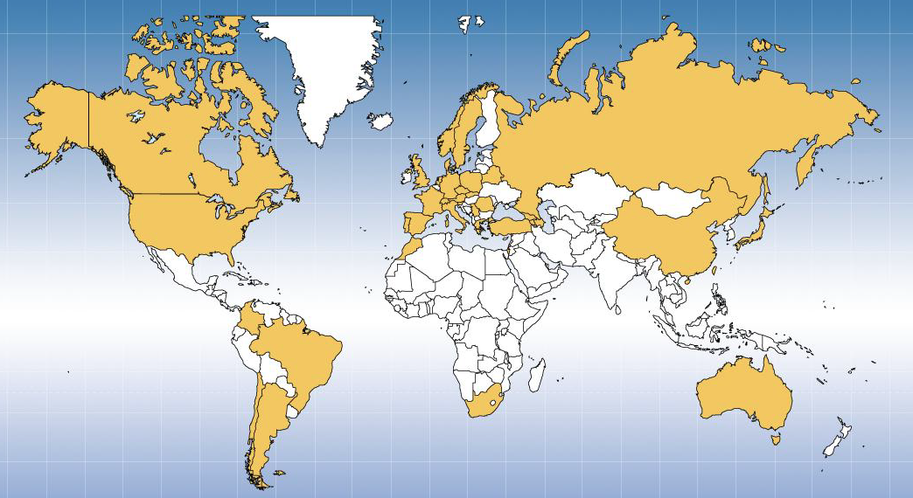
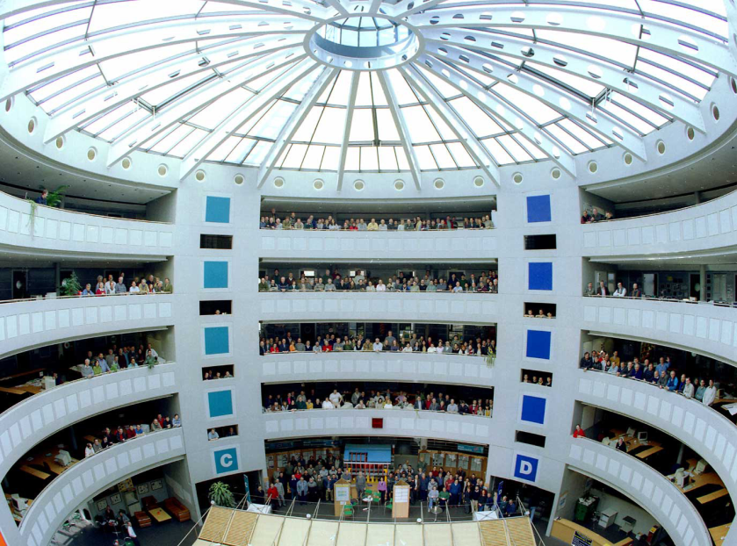
ATLAS Experiment
  The ATLAS is one of the six particle detectors at Large Hadron Collider (LHC) at CERN, one of the two general purpose detectors
The ATLAS Experiment at LHC is an international collaboration of about 3000 scientists and engineers from 38 countries. They come from 174 Universities and Labs. There are about 1200 graduate students working in ATLAS
Notes:
ATLAS is a multipurpose detector at LHC at CERN.
The ATLAS Experiment at LHC is an international collaboration of about 3000 scientists and engineers from many universities and labs around the globe.
It took almost 20 years to build ATLAS. But never the less this is young collaboration with 1200 graduate students working on ATLAS.

Slide 3
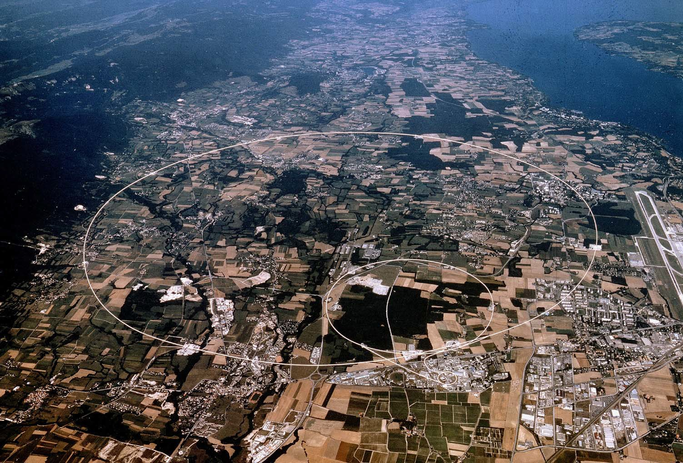
Large Hadron Collider. View from above
The LHC is one of the largest scientific instruments ever built
The LHC is the worlds largest and highest-energy particle accelerator
Geneva
Lake
CMS
LHCb
Airport
ALICE
ATLAS
CERN
Notes:
This photo shows the outline of the LHC tunnel on an aerial view of countryside around Geneva.
The LHC is one of the largest scientific instruments ever built and certainly one of the most complex.
Everything about LHC is extreme, it’s size, it’s energy, it’s detectors.
It’s the coldest place in the solar system, it’s the hottest place in the universe.

Slide 4
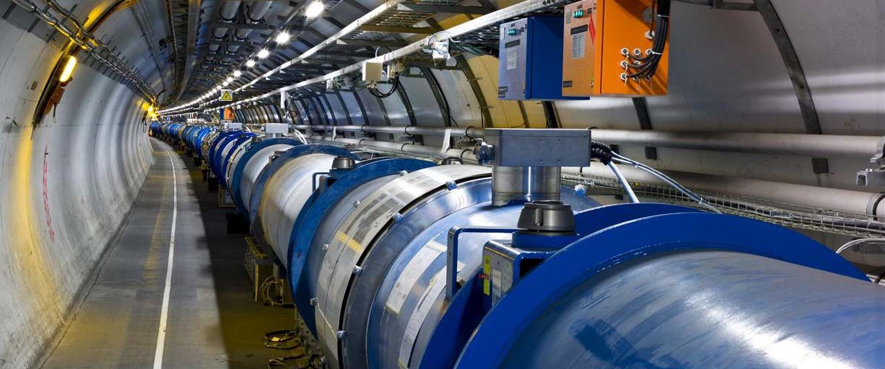
Large Hadron Collider. View from below
The LHC tunnel is 26,659 meters long, with ~9600 superconducting magnets needed to accelerate and collide protons and heavy ions at the highest energy ever achieved in laboratory - 14 TeV
Largest cryogenic installation in the world

Slide 5
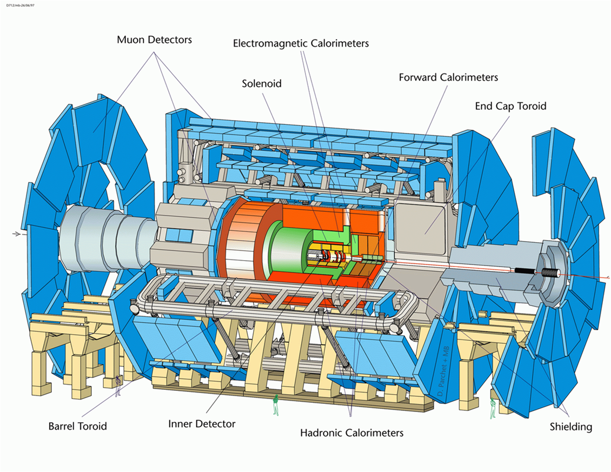
ATLAS Detector
Length : ~46 m (150 ft)
Radius : ~12 m (40 ft)
Weight : ~7000 tons
~10⁸ electronic channels
~ 1800 miles of cables
~10 MW of electric power
2 to 4 Tesla mag. field
Person

Slide 6
Mr Big and Mr Heavy
6 Floors
5
4
3
2
1
0
Notes:
Atlas: barrel air-torroid. Also barrel solenoid (2T).

Slide 7

ATLAS Underground

Slide 8
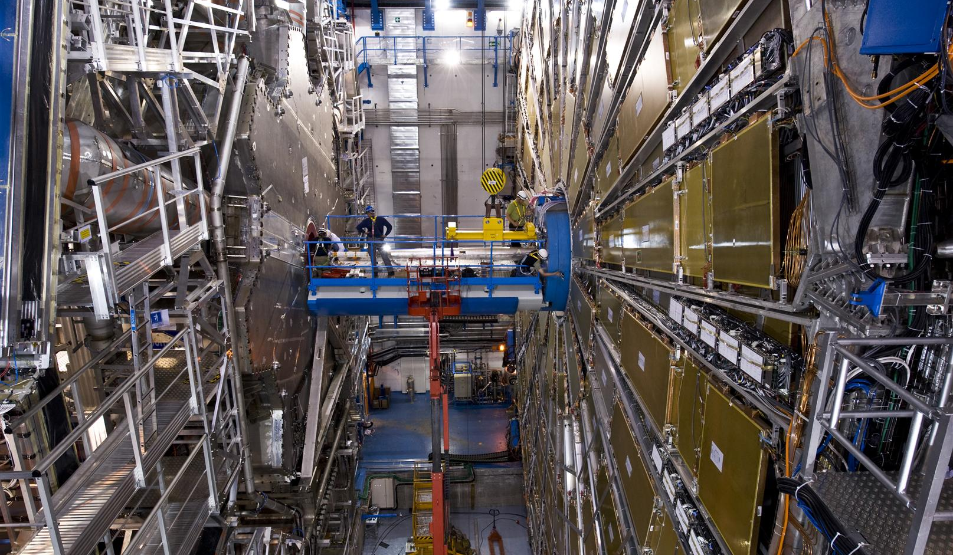
ATLAS Detector

Slide 9
ATLAS Physics Goals
Search for:
Standard Model Higgs boson over ~ 115 < m_{H} < 1000 GeV range
Physics beyond the SM up to the TeV-range
Supersymmetry , Dark Matter
q/ compositeness
leptoquarks, W’/Z’
Quark Gluon Plasma
Extra-dimensions, mini black holes, Dark Energy, …….
Precise measurements :
W mass
top quark mass, couplings and decay properties
Higgs mass, spin, couplings
B-physics: CP violation, rare decays, B⁰ oscillations
QCD jet cross-section and α_{s}

Slide 10

Higgs Boson Discovery
Two seminars from CMS and ATLAS were given on July 4, 2012 at CERN.
>10,000 print stories
>1,034 television spots (worldwide)
Two publications were submitted on July 31, 2012

Slide 11

Higgs Boson Discovery

Slide 12
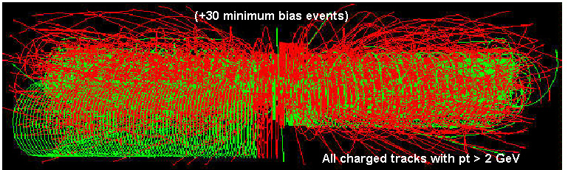
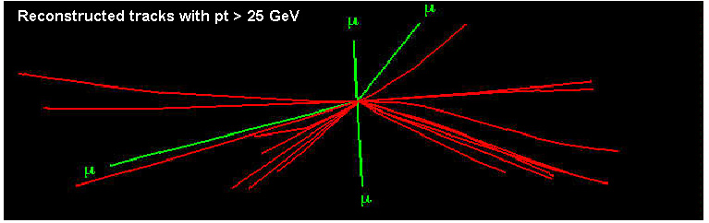
ATLAS Data Challenge
The ATLAS Data Challenge
800,000,000 proton-proton interactions per second
0.0002 Higgs per second
~150,000,000 electronic channels
>10 PBytes of data per year
Starting from this event…
We are looking for this “signature”
Selectivity: 1 in 10¹³
Like looking for 1 person in a thousand world populations
Or for a needle in 20 million haystacks!
Notes:
Particles that we want to discover and study are rare – that’s why LHC runs at such high energy and with such intense beams –almost a billion interactions per second. Even at this conditions you would need to search for one Higgs in more than a trillion events.
At high beam densities - we call this property “beam luminosity” – multiple collisions can occur in one beam crossing. Figure shows how such event look. It’s quite “messy”. That explains why you need such a big detector, with large granularity and so many sensor channels.

Slide 13
ATLAS – The Big Data Experiment
ATLAS Detector generates about 1PB of raw data per second – most filtered out in real time by the trigger system
Interesting events are recorded for further reconstruction and analysis
As of 2013 ATLAS manages ~140 PB of data, distributed world-wide to 130 WLCG computing centers
  Expected rate of data influx into ATLAS Grid ~40 PB of data per year in 2014
  Thousands of physicists from ~40 countries analyze the data

Slide 14
ATLAS Computing
ATLAS uses grid computing paradigm to organize distributed resources
ATLAS computational resources are managed by PanDA Workload Management System
  Production and Data Analysis system
  Grid meta scheduler
Now successfully manages O(10²) sites, O(10⁵) cores, O(10⁸) jobs per year, O(10³) users

Slide 15
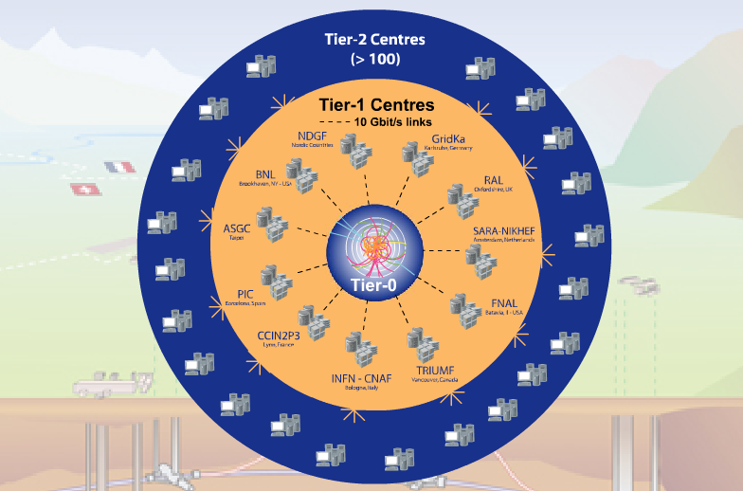
LHC Computing Grid
Tier-0 (CERN): (15%)
  Data recording
  Initial data reconstruction
  Data distribution
Tier-1 (11 centres): (40%)
Permanent storage
Re-processing
Analysis
Connected by direct 10 Gb/s network links
Tier-2 (~200 centres): (45%)
Simulation
End-user analysis
15%
45%
40%
Notes:
The Tier 0 centre at CERN stores the primary copy of all the data. A second copy is distributed between the 11 so-called Tier 1 centres. These are large computer centres in different geographical regions of the world, that also have a responsibility for long term guardianship of the data. The data is sent from CERN to the Tier 1s in real time over dedicated network connections.
In order to keep up with the data coming from the experiments this transfer must be capable of running at around 1.3 GB/s continuously. This is equivalent to a full DVD every 3 seconds.
The Tier 1 sites also provide the second level of data processing and produce data sets which can be used to perform the physics analysis. These data sets are sent from the Tier 1 sites to the around 130 Tier 2 sites.
A Tier 2 is typically a university department or physics laboratories and are located all over the world in most of the countries that participate in the LHC experiments. Often, Tier 2s are associated to a Tier 1 site in their region. It is at the Tier 2s that the real physics analysis is performed.
----- Meeting Notes (5/8/13 00:20) -----
Organizationally, the grid is set up in a tier system, with the Large Hadron Collider located at CERN, the Tier-0 center. CERN receives the raw data from the ATLAS detector, performs a first-pass analysis, and then distributes it among ten Tier-1 locations, also known as regional centers, including Brookhaven. At the Tier-1 level, which is connected to Tier-0 via a dedicated high-performance optical network path, a fraction of the raw data is stored, processed, and analyzed. Each Tier-1 facility then distributes derived data to Tier-2 computing facilities that provide data storage and processing capacities for more in-depth user analysis and simulation.

Slide 16
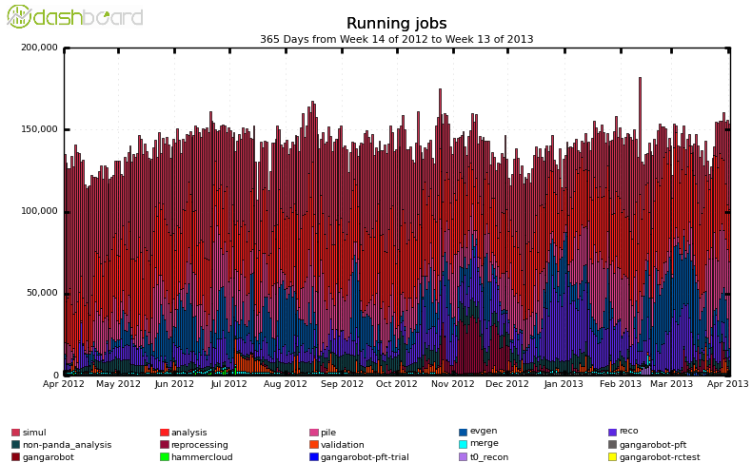
ATLAS Distributed Computing
150k
Includes user and group analysis and Monte-Carlo simulations on ATLAS Grid
Running on ~100,000 cores worldwide
Available resources fully used/stressed

Slide 17
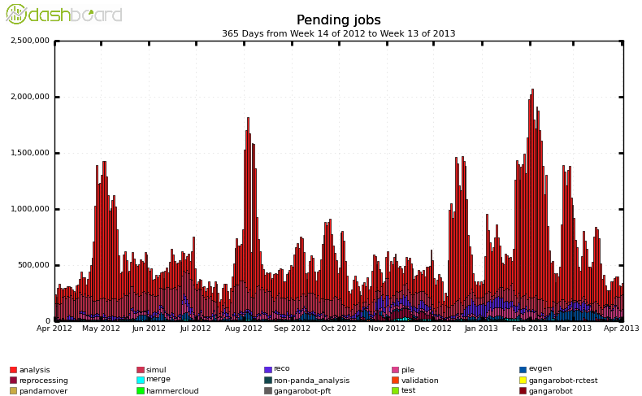
ATLAS Distributed Computing II
Spikes in demand for computational resources
Can significantly exceed available ATLAS Grid resources
Lack of resources slows down pace of discovery

Slide 18
Cloud Computing and ATLAS
A few years ago ATLAS set up cloud computing project to exploit virtualization and clouds
  Utilize private and public clouds as an extra computing resource
  Mechanism to cope with peak loads on the Grid
Experience with variety of cloud platforms
  Amazon EC2
  Helix Nebula project (CloudSigma, T-Systems and ATOS )
  Futuregrid (U. Chicago), Synnefo cloud (U. Victoria)
  RackSpace
  Private clouds based on OpenStack, CloudStack, OpenNebula, etc…
  Recent project on Google Compute Engine (GCE)

Slide 19
ATLAS and Google Compute Engine
We were invited to participate in GCE trial period in August 2012
  Attracted by modern hardware, powerful API, competitive pricing.
  And this is Google!
  Frustrated that none of the tools that we use supported GCE at that time
    Initially a lot of manual labor in image building
    Limited set of base images. No SL5 !
    Can not upload our own images
Google was very gracious in providing more resources than the initial trial quota
Also GCE engineers were very helpful

Slide 20
ATLAS and Google Compute Engine
We wanted to try several things on GCE:
  High performance analysis clusters (PROOF based and other)
  Cloud storage and data management
  Use of Xroot for Cloud storage aggregation and interaction with ATLAS Xroot federation
    We will talk about Xroot technology in more details later
  PanDA queue for Monte Carlo Simulations

Slide 21
PanDA batch queue on GCE
US ATLAS negotiated with Google expansion of the GCE preview project
Google agreed to allocate additional resources for ATLAS
  ~5M core-hours, 4000 cores for about 2 month, (original preview allocation was 1k cores)
Resources were organized as HTCondor based PanDA queue
Transparent inclusion of cloud resources into ATLAS Grid
The idea was to test long term stability while running a cloud cluster similar in size to Tier 2 site in ATLAS
Intended for CPU intensive Monte-Carlo simulation workloads
Planned as a production type of run. Delivered to ATLAS as a resource and not as an R&D platform.
  Centos 6 based custom built images,
  HTCondor head nodes, CVMFS proxies at BNL
  Output transfer to ATLAS storage at BNL
  Ganglia monitoring on OS level for the whole cluster

Slide 22
PanDA batch queue on GCE II
We ran for about 8 weeks (2 weeks were planned for scaling up)
Very stable running on the Cloud side. GCE was rock solid.
Most problems that we had were on the ATLAS side.
We ran various physics event generators
Completed 458,000 jobs
Generated and processed about 214 M events
  Physics event generators
  Fast detector simulation
  Full detector simulation

Slide 23
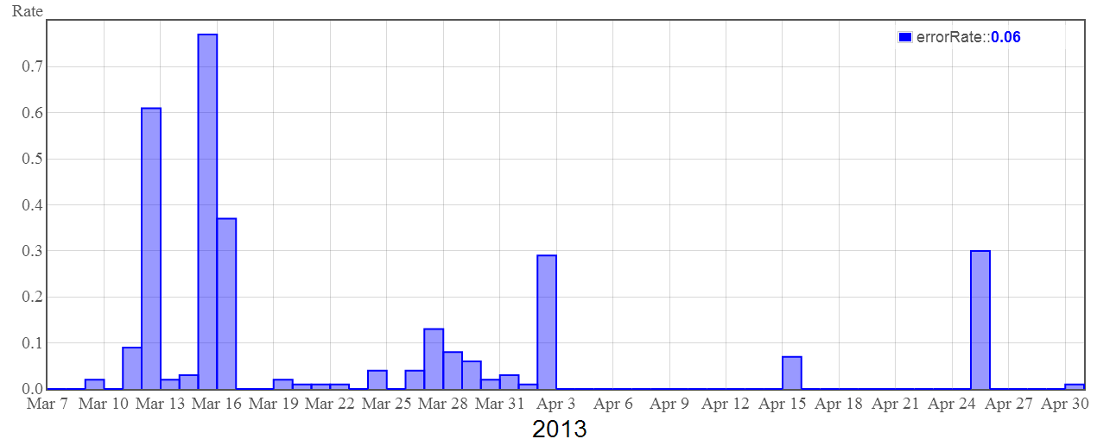
PanDA queue on GCE. Failure Rate
Most of the job failures occurred during start up and scale up phase – as expected
Most of the failures were on the ATLAS side – file transfer, LFC problems, HTCondor
No failures were due to GCE problems

Slide 24
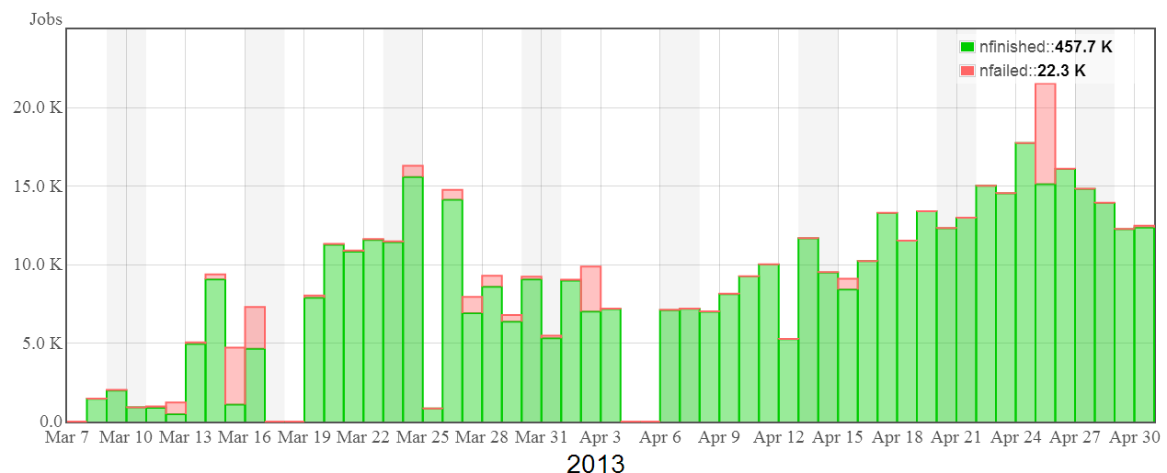
Failed and Finished Jobs
Most of the job failures occurred during start up and scale up phase – as expected
Reached throughput of 15k jobs per day

Slide 25
PROOF/Xroot Clusters on GCE
PROOF is implementation of MapReduce paradigm based on ROOT framework.
ROOT framework for data analysis in HENP
  Developed and supported by ROOT Team at CERN
  Written in C++
  Free, Open Source
  More info at: http://root.cern.ch/ ; http://root.cern.ch/drupal/content/proof
PROOF allows for efficient aggregation and use of distributed computing resources for data intensive event based analyses
Uses Xroot for clustering, storage aggregation and data discovery
  Xroot is well suited for ephemeral storage aggregation into one name space
PROOF clusters can be federated

Slide 26
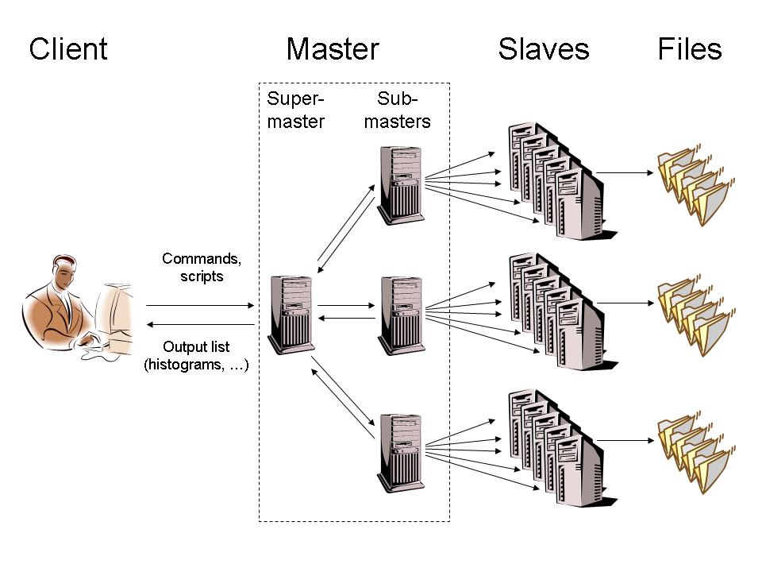
PROOF Architecture
Adapts to wide area virtual clusters
Geographically
separated domains,
heterogeneous
machines
Super master is users' single point of entry. System complexity is hidden from users
Automatic data discovery via Xroot and job matching with local data
Can be optimize for data locality or high bandwidth data server access

Slide 27
PROOF/Xrootd Cluster
Master Node
Proof
Xroot
Worker Node 1
WN 2
WN 3
WN N
Proof
Proof
Proof
Proof
Xroot
Xroot
Xroot
Xroot
Single name space

Slide 28
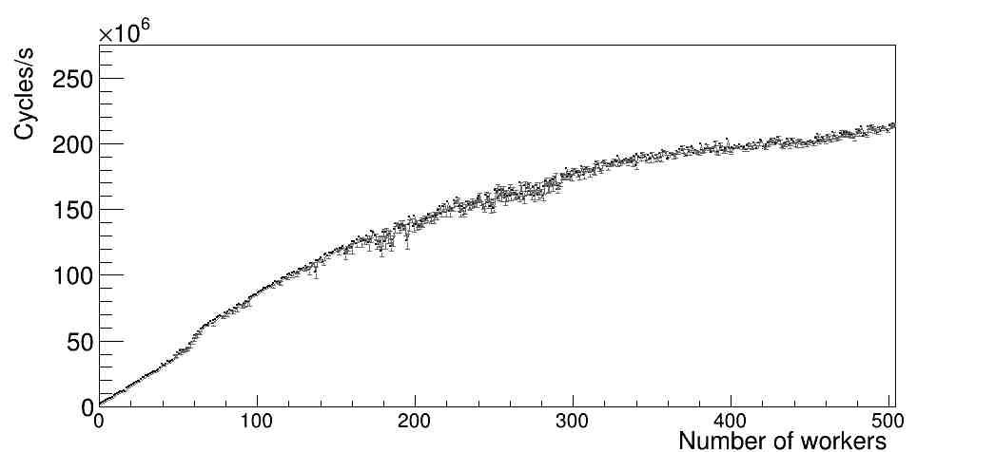
PROOF Tests on GCE
Access to GCE allowed us to build and test large PROOF clusters, up to 1000 workers
Figure shows scalability test for 500 worker PROOF cluster
  n1-standard-8-d type instances
  Very good performance

Slide 29
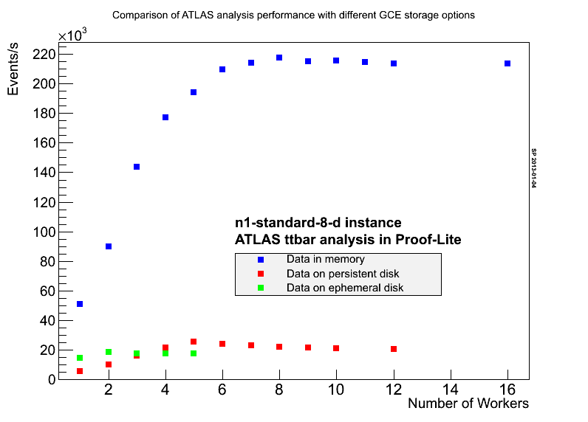
GCE storage performance comparison
Single PROOF node
Single disk
1 TB persistent
1.7 TB ephemeral
Persistent disk shows better scaling and peak performance.
Note that ephemeral disk has better single worker performance
RAID is needed for better performance

Slide 30
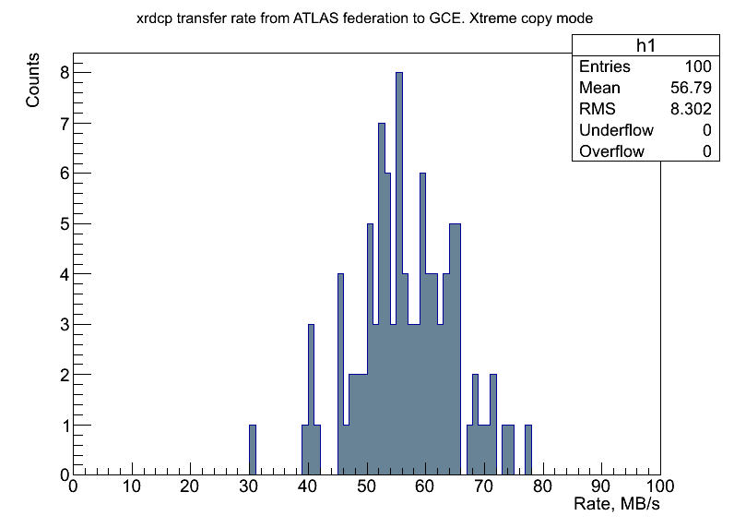
Data transfers from FAX to GCE
Data transfer from Federated ATLAS Xroot (FAX) to GCE in multisource/multi-stream mode
GCE Xroot cluster using ephemeral storage with 1.7 TB volumes per node
Average transfer rate: 57 MB/s (single source xrdcp rate 40 MB/s)
Note, this is over public networks

Slide 31

What Is XRootD
A system for scalable cluster data access
Not a file system
Not just for file systems
If you can write a plug-in you can cluster it
xrootd
cmsd

Slide 32
XRootD Plug-in Architecture
32
Protocol Driver
Any n protocols
Authentication
krb5 sss x.509 …
Protocol
cms http xroot …
Authorization
Entity Names
Logical File System
dpm sfs sql …
Storage System
HDFS gpfs Lustre UFS, …
Clustering
(cmsd)

Slide 33
Data Access Problem
The High Energy Physics analysis regime
  Write once read many times access mode
  Thousands of parallel batch jobs
  Small block sparse random I/O

Slide 34
Synergistic Solution
Minimize latency
Minimize hardware requirements
Minimize human cost
Maximize scaling

Slide 35
Scaling Using B⁶⁴ Trees
xrootd
cmsd
xrootd
xrootd
cmsd
xrootd
cmsd
Manager
(Root Node)
cmsd
Private Cloud
xrootd
64¹ = 64
xrootd
cmsd
cmsd
64² = 4096
xrootd
xrootd
xrootd
xrootd
Supervisors
(Interior Nodes)
cmsd
cmsd
cmsd
cmsd
xrootd
xrootd
64³ = 262144
xrootd
xrootd
cmsd
cmsd
cmsd
cmsd
64⁴ = 16777216
Data Server
(Leaf Nodes)
xrootd
xrootd
xrootd
xrootd
cmsd
cmsd
cmsd
cmsd
GCE Ephemeral Storage
Private Cluster
How does a client get to a leaf?

Slide 36
Routing Clients To The Data
open()
redirect
open()
Client
redirect
open()
xrootd
cmsd
64¹ = 64
xrootd
xrootd
cmsd
cmsd
64² = 4096
xrootd
xrootd
xrootd
xrootd
cmsd
cmsd
cmsd
cmsd

Slide 37

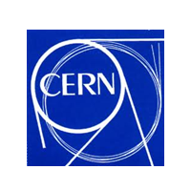




XRootD Bottom Line
A simple, flexible, and effective system
  But the devil is in the details
    See “Scalla: Structured Cluster Architecture for Low Latency Access”, IEEE IPDPSW 2012, Page(s): 1168 – 1175
LGPL open-source
Managed by the XRootD collaboration
  SLAC, CERN, Duke, JINR, UCSD, & UNL (spring)
Check out http://xrootd.org/

Slide 38
Summary
Great experience with Google Compute Engine
Tested several computational scenarios on GCE
  PROOF clusters for data analysis
  Xroot for cloud storage and federation
  PanDA batch cluster for Monte Carlo Simulations
Ran large scale Monte Carlo production on GCE
We think that GCE is modern cloud infrastructure that can serve as a stable, high performance platform for scientific computing
Tools developed by LHC community may be of interest for a broader community of developers working on GCE and other cloud platforms
  Xroot, PROOF, ROOT, etc

