Slide 1
XROOTD Tutorial
Part 2 – the bundles
Fabrizio Furano

Slide 2
Why bundles?
We have just had an experience with a very simple setup, with no clustering, no tapes, no WAN stuff…
The config can become very complex, a lot of parameters can be modified/tuned
Several plugins (also third-party) may be needed
Many of the parameters are not related to basic file serving
Sometimes the requirements are complex, hence the config can get complex
The idea was to have a ‘ready-go’ approach
Setup + configure only basic stuff to have a pre-configured full system
Eventually create an RPM
The most famous is the one used by ALICE, a very generic setup but with a lot of advanced features
There is at least one more example around

Slide 3
The vMSS (1/2)
A very good example of encapsulated complexity that comes with the most widely used bundle.
Different sites can be clustered and participate to a global name space
They subscribe to the so-called Global Redirector
Each site thinks that it has a tape-like backend
Instead it is not tape, it’s the possibility of fetching files from an external xrootd cluster
This cluster can be external or can be made by the same sites clusterized together
Testing this thing is very difficult. This is why it comes in an encapsulated way.
Also… an error in a site may be caused by an issue in another one.

Slide 4
The vMSS (2/2)
A globalized cluster
global redirector
A smart client
could point here
Xrootd
Cmsd
Local clients work
Normally at each site
Xrootd site
Xrootd site
Any other
Xrootd site
Missing a file?
The storage asks to the global redirector
Gets redirected to the right
collaborating cluster, and fetches it.
Immediately.
Virtual
Mass
Storage
System
… built on data Globalization

Slide 5
Xrd-installer
xrd-installer [--install] [-h] [-l] [n] [-p packagename] [--prefix install-prefix] [--version version] [--compiledir compile-directory] [--noclean]
where the meaning of the switches is:
-l : list packages
-p name : select package
-n : don't install autotools
--noclean : don't cleanup the compilation directory
--install : install all packages or the selected packages with -p option
--prefix : set the installation prefix (default /home/alientest/xrdserver)
--version : select the version to install (default is PRO)
--compiledir

Slide 6
Simplified setup
The xrd-installer setup is similar to a meta-package
Originally developed by A.Peters and D.Feichtinger
Usage: same of before
Download the installer script
wget http://project-arda-dev.web.cern.ch/project-arda-dev/xrootd/tarballs/installbox/xrd-installer
Run it as NON-root user
xrd-installer –install –prefix=<inst_pfx> [--version=<version>]
Then, a small file contains the important parameters (about 10)
Geeks can also use the internal xrootd config file template
And have access to really everything
Needed only for very particular things, i.e. almost never

Slide 7
Watchdog
The xrd-installer related scripts provide a very useful watchdogging feature
Every 5 minutes the status of the daemons is checked
If it’s not OK then they are restarted
Clients do not crash, they are able to cope with that
This means that, if the intervention time is small, one can upgrade servers without draining jobs
Some setups accept the WAN traffic, so the concept of ‘draining’ does not apply
In my experience, the downtime for an upgrade is <1 minute

Slide 8
Pre-requirements (1/3)
Software pre-requirements
Libxml2 (lib+headers)
Often used by authz plugins
openssl (lib+headers)
The xrootd authz plugins are built around this
Autoconf/libtool
Several 3rd party plugins use this
Swig
Needed to build the perl interface to xrootd
Zlib
Needed to calculate checksums in xrdcp

Slide 9
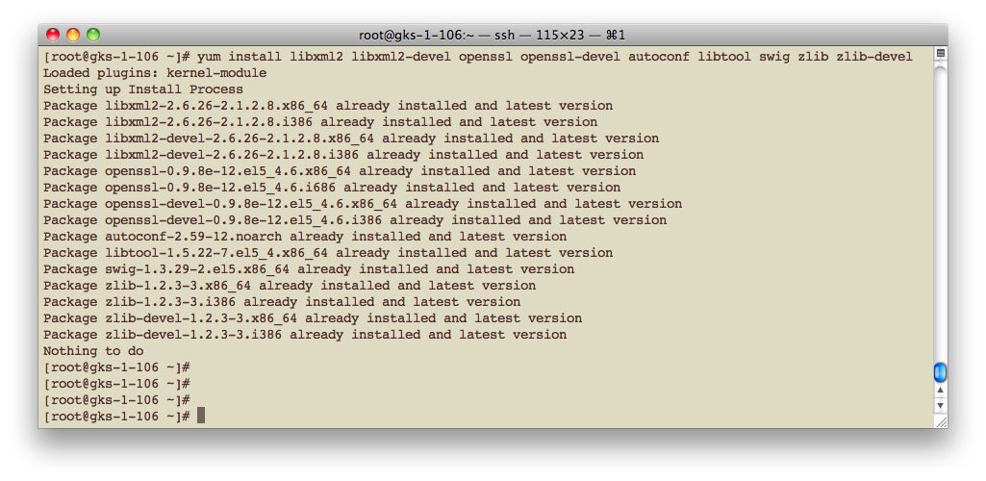
Pre-requirements (2/3)
These are the names for SLC5.4
For other distros they could be slightly different

Slide 10
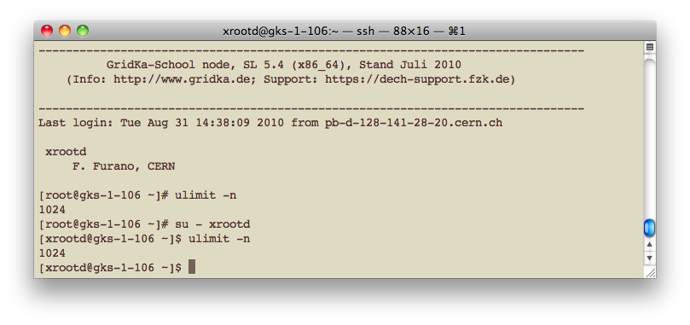
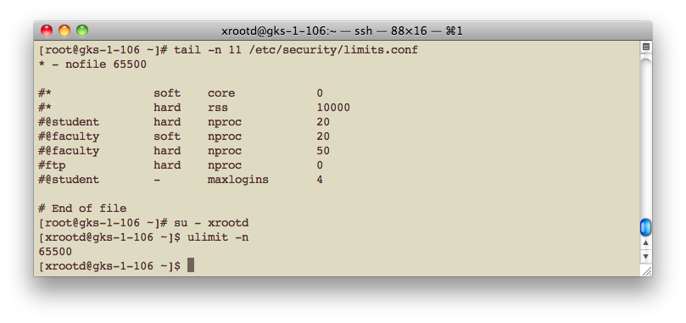
Pre-requirements (3/3)
The fds … before
Bad!
… after
Good!

Slide 11
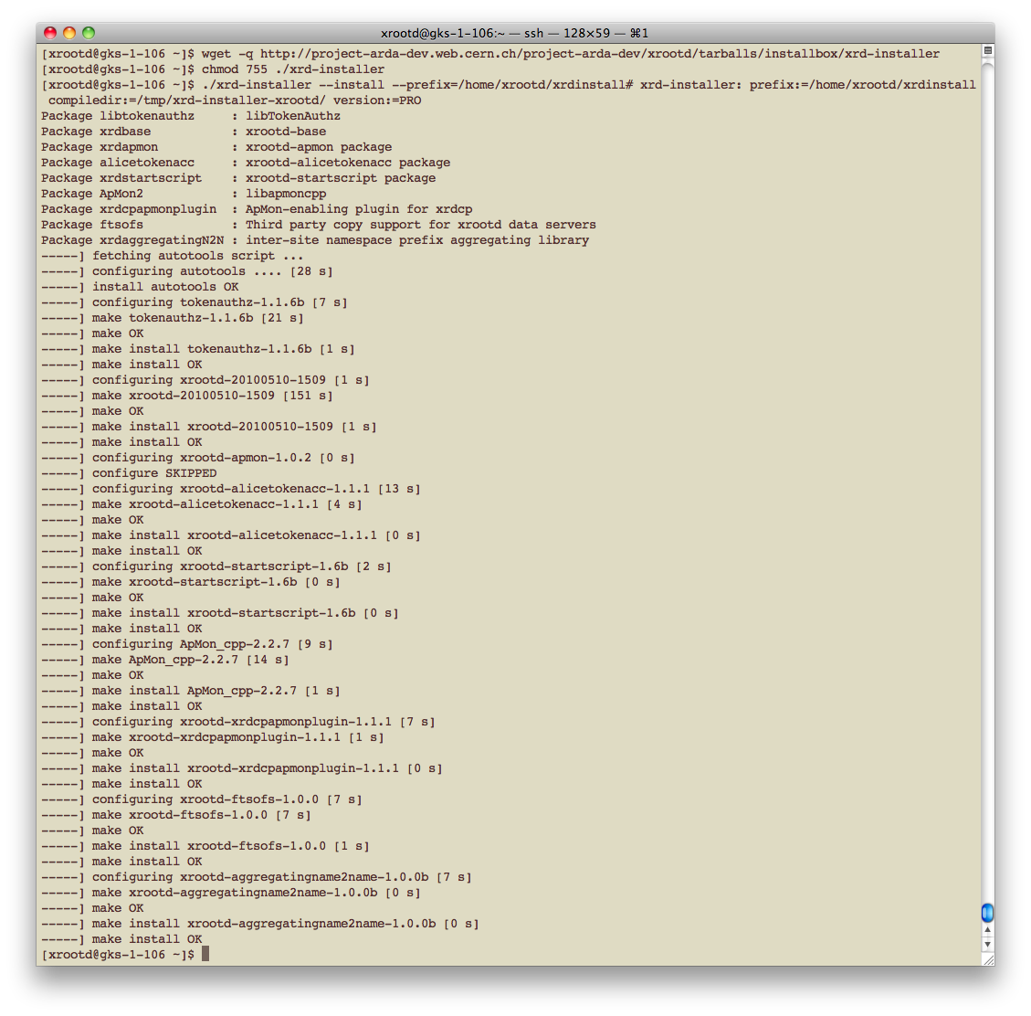
Bundled setup

Slide 12
Several bundles
The idea is that an experiment (or a group) relies on a pre-configured bundle for an homogeneous set of sites
Built on their requirements
Hence, we may think as if several flavors exist
Once one has the name of the flavor, this can be specified with the --version=<xyz> parameter
We will play with the most used one.
A generic setup with advanced features
Global redirection support
2 ALICE plugins (that will be left disabled, we don’t need)
We are going to setup our class-wide cluster!

Slide 13
Compilation
All the packages are compiled for the platform in use
If all the pre-reqs are met generally there are no troubles
If any of the results looks like “FAILED”, well …
We must understand why, fix the problem
And redo it again

Slide 14
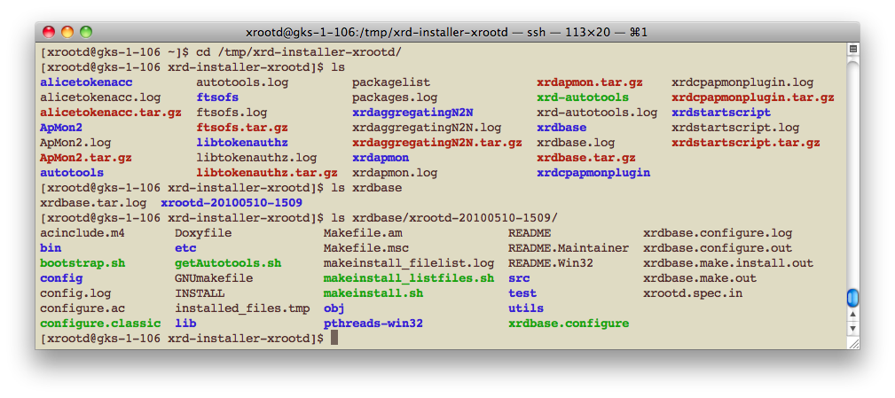
Compilation troubles?
All the packages, d/l logs, configure logs, make logs are kept into /tmp/xrd-installer<username>
Have a check on the directory structure: one directory per plugin

Slide 15
System.cnf
This is the meta-configuration file, available in
<path>/etc/xrootd/system.cnf
It hosts only “easy” parameters
Internally, it is processed and the true xrootd config files are created from it.
It’s supposed to cover:
90% of the generic requirements about xrootd deployment
101% of the requirements of the group/experiment that creates a bundle for its sites

Slide 16
A note on the file descriptors
The purpose of a server is to handle clients
What else? Otherwise it is useless
Hence the machine has to be configured as a server, meaning typically:
Good TCP configuration
The SLC defaults are often very bad
Look here: http://monalisa.cern.ch/FDT/documentation_syssettings.html
All the OS resources are available
Max overall number of file descriptors (per machine, not per user)
The max # of file descriptors per user is >65000
In the Alien Howtos there is a good recipe for that
http://alien.cern.ch/twiki/bin/view/AliEnHowToInstallXrootdNew
Even too much for most distros. Follow it until the requirement is met.
Xrootd will not start if this is not met.

Slide 17
Important config options
VMSS_SOURCE: where this cluster tries to fetch files from, in the case they are absent.
LOCALPATHPFX: the prefix of the namespace which has to be made "facultative” (not needed by everybody)
LOCALROOT is the local (relative to the mounted disks) place where all the data (or the namespace) is put/kept by the xrootd server.
OSSCACHE: probably your server has more than one disk to use to store data. Here you list the mountpoints where the data is stored.
MANAGERHOST: the redirector’s name
SERVERONREDIRECTOR: is this machine both a server and redirector?
OFSLIB: the filesystem plugin library to be used in xrootd. May be the ALICE particular authz plugin.
METAMGRHOST, METAMGRPORT: host and port number of the meta-manager (global redirector) where to subscribe.
XRDUSER
The name of the user which runs the daemons (e.g. xrootd, aliprod)

Slide 18
Config options
MANAGERHOST
The name of the machine hosting the redirector
Execute in the redirector machine:
hostname –f and copy/paste the result
The redirector and all the data servers will understand their role from this information
Automagically
So, this string must be the same for all the machines of the cluster

Slide 19
Config options
SERVERONREDIRECTOR
Is your cluster small (1-2-3 machines)?
If so, you can use a machine to host BOTH the redirector services and the data server services. If you like this, put “1”
You need decent hw to do that
Reconsider this when you add new servers
Otherwise put “0” (zero)

Slide 20
Config options
XRDUSER
The daemons will be run under a user’s credentials
Typically everybody uses “xrootd”
Write here the name of this system user
MAKE SURE IT EXISTS
MAKE SURE IT HAS A HOME DIRECTORY
MAKE SURE IT’S NOT ROOT

Slide 21
Config options
METAMGRHOST, METAMGRPORT
This is the address of the Global redirector
Through this, this cluster is accessible in the global domain
VMSS_SOURCE
Also this is the URL prefix that points to the Global Redirector
Through this, the cluster auto-feeds itself from the global domain in the case of missing files opened for READ

Slide 22
Config options
OFSLIB
Namely, the name of the filesystem plugin used
The way the ALICE strong auth works
Specify TokenAuthzOfs to enable the ALICE authz
Mandatory for ALICE
Writing is only allowed via the auth of the central services
Specify Ofs to use the default xrootd plugin

Slide 23
Config options
LOCALROOT
The place where the xrootd daemon puts the written data
Something like:
/mydisk1/xrdfiles/
If you are aggregating multiple partitions (OSSCACHE option) then you will put something like this:
/mydisk1/data/xrdnamespace
This is going to be your most important directory
Keep it separated from the others!
Technically you don’t need to back it up, in the case of disasters the best thing to do is to recreate it

Slide 24
Config options
LOCALPATHPFX
Makes a part of the paths optional. In order to create an internal aliasing.
If the path does not start with this pfx, then it is prepended
If the path already starts with this pfx, it’s left as it is
The “old style” local prefix to the ALICE data (if this is an ALICE SE…)
Almost nobody is using it (hopefully)
Hence, it’s generally an empty string, except for very particular cases

Slide 25
Config options
OSSCACHE
Here you list (with the xrootd syntax) the xrootd config lines that configure the cache file system, separated by “\n”
e.g. if your machine can use as raw storage
/data/disk1 and
/data/disk2
HINT: don’t put data in the root dir of a mountpoint. It works but it’s uncomfortable… then do:
“oss.cache public /data/disk1/xrddata\noss.cache public /data/disk2/xrddata”

Slide 26
Setup: start and stop
Check the status of the daemons
<full path>/xrd.sh
Check the status of the daemons and start the ones which are currently not running (and make sure they are checked every 5 mins). Also do the log rotation.
<full path>/xrd.sh -c
Force a restart of all daemons
<full path>/xrd.sh -f
Stop all daemons
<full path>/xrd.sh -k

Slide 27
Logfiles
The logfiles are gathered in the same place:
<install_path>/logs
<install_path>/logs/server
(if this machine is running a data server)
<install_path>/logs/manager
(if this machine is running a manager/redirector)
We are interested mainly in ‘xrdlog’ and ‘cmslog’
This is what you are asked for in the case of reports or requests for assistance

Slide 28
Let’s do it (1/5)
Exercise… we will:
setup an xrootd data server in each machine
clusterize them all into ONE cluster
Play with xrdcp and xrd to familiarize

Slide 29
Let’s do it (2/5)
You are now xrd-installer experts
Eventually scratch the previous attempts (before you have to kill the daemons with xrd.sh!!)
If you just kill them with kill they will pop up again
OR… install the new one in a parallel directory
E.g. /home/xrootd/xrdinstall2
Configure it completely
Stop the previous one with <path1>/xrd.sh –k
This also removes the watchdog
Start the new one with <path2>/xrd.sh –f

Slide 30
Let’s do it (3/5)
When the crude setup/compilation is done, we have to fill system.cnf
We want to export the common namespace /gridka2010
Choose a suitable place where to put 2 fake mountpoints
In practice 2 directories
Use those directories as you would use mountpoints

Slide 31
Let’s do it (4/5)
The clusterization
I will setup the redirector
All the data servers should point here
The machine’s name will be known the day of the tutorial…

Slide 32
Let’s do it (5/5)
Everybody should use xrdcp to write 10 files, 10M each
Into the cluster of course, not into your server
Full pathname: root://unique_redirector//gridka2010/<your_name>_N.dat
At the end, each machine should host files at random
Verify that some load is spread to your machine
If not, you have to understand why

Slide 33
I want to migrate/clean up
Too many different situations
E.g. Differences in the number of servers, in the partition sizes, in the partition numbers, …
Hence a single recipe is difficult to invent…
Better to understand how it works and be prepared
BUT … The files are there
They are “in clear”
Easy with one partition per server
Just do it with the normal UNIX tools
But, with OSSCACHE we have also the need to migrate/recreate the namespace part, made of symlinks
Every case is different, I never saw the same thing twice
In the worst cases a small shell script does the job

Slide 34
In any case
There is the help of the community and of the more experienced sysadmins
Mailing lists of the various experiments/groups
http://savannah.cern.ch/project/xrootd
Xrootd-l@slac.stanford.edu
In general, in case of bad hw failures:
All the data files that can be read with standard UNIX tools are easily recoverable
Eventually, one may have to recreate the namespace for the new set of files

