Slide 1
Scalla/xrootd 2009 Developments
Andrew Hanushevsky
SLAC National Accelerator Laboratory
Stanford University
12-October-2009
CERN Update
http://xrootd.slac.stanford.edu/

Slide 2
Outline
System Component Summary
Recent Developments
Scalability, Stability, & Performance
ATLAS Specific Performance Issues
Faster I/O
The SSD Option
Future Developments

Slide 3
Recap Of The Components
xrootd
Provides actual data access
cmsd
Glues multiple xrootd’s into a cluster
XrdCnsd
Glues multiple name spaces into one name space
BeStMan
Provides SRM v2+ interface and functions
FUSE
Exports xrootd as a file system for BeStMan
GridFTP
Grid data access either via FUSE or POSIX Preload Library

Slide 4
Recent 2009 Developments
April: File Residency Manager (FRM)
May: Torrent WAN transfers
June: Auto summary monitoring data
July: Ephemeral files
August: Composite Name Space rewrite
Implementation of SSI (Simple Server Inventory)
September: SSD Testing & Accommodation

Slide 5
File Residency Manager (FRM)
Functional replacement for MPS¹ scripts
Currently, includes…
Pre-staging daemon frm_pstgd and agent frm_pstga
Distributed copy-in prioritized queue of requests
Can copy from any source using any transfer agent
Used to interface to real and virtual MSS’s
frm_admin command
Audit, correct, and obtain space information
Space token names, utilization, etc.
Can run on a live system
Missing frm_migr and frm_purge
¹Migration
Purge
Staging

Slide 6
Torrent WAN Transfers
The xrootd already supports parallel TCP paths
Significant improvement in WAN transfer rate
Specified as xrdcp –S num
New Xtreme copy mode option
Uses multiple data sources bit torrent-style
Specified as xrdcp –x
Transfers to CERN; examples:
1 source (.de): 12MB/sec ( 1 stream)
1 source (.us): 19MB/sec ( 15 streams)
4 sources (3 x .de + .ru): 27MB/sec ( 1 stream each)
4 sources + || streams: 42MB/Sec (15 streams each)
5 sources (3 x .de + .it + .ro): 54MB/Sec (15 streams each)

Slide 7
Torrents With Globalization
BNL
all.role meta manager
all.manager meta atlas.bnl.gov:1312
xrootd
Meta Managers can be
geographically replicated!
xrdcp –x xroot://atlas.bnl.gov//myfile /tmp
cmsd
xrootd
xrootd
xrootd
cmsd
cmsd
cmsd
/myfile
/myfile
SLAC
Cluster
UOM
Cluster
UTA
Cluster
all.manager meta atlas.bnl.gov:1312
all.manager meta atlas.bnl.gov:1312
all.manager meta atlas.bnl.gov:1312
all.role manager
all.role manager
all.role manager

Slide 8
Manual Torrents
Globalization simplifies torrents
All real-time accessible copies participate
Each contribution is relative to each file’s transfer rate
Will be implementing manual torrents
Broadens the scope of xrdcp
Though not as simple or reliable as global clusters
xrdcp –x xroot://host1,host2,…/path . . .
Future extended syntax

Slide 9
Summary Monitoring
xrootd has built-in summary & detail monitoring
Can now auto-report summary statistics
Specify xrd.report configuration directive
Data sent to one or two locations
Accommodates most current monitoring tools
Ganglia, GRIS, Nagios, MonALISA, and perhaps more
Requires external xml-to-monitor data convertor
Can use provided stream multiplexing and xml parsing tool
mpxstats
Outputs simple key-value pairs to feed a monitor script

Slide 10
Summary Monitoring Setup
monhost:1999
Monitoring
Host
mpxstats
ganglia
Data
Servers
xrd.report monhost:1999 all every 15s

Slide 11
Ephemeral Files
Files that persist only when successfully closed
Excellent safeguard against leaving partial files
Application, server, or network failures
E.g., GridFTP failures
Server provides grace period after failure
Allows application to complete creating the file
Normal xrootd error recovery protocol
Clients asking for read access are delayed
Clients asking for write access are usually denied
Obviously, original creator is allowed write access
Enabled via xrdcp –P option or ofs.posc CGI element

Slide 12
Composite Cluster Name Space
Xrootd add-on to specifically accommodate
users that desire a full name space “ls”
XrootdFS via FUSE
SRM
Rewrite added two features
Name space replication
Simple Server Inventory (SSI)

Slide 13
Composite Cluster Name Space
opendir() refers to the directory structure maintained by xrootd:2094
XrdCnsd can now be run stand-alone to manually re-create a name space or inventory
Client
Redirector
xrootd@urhost:1094
Redirector
xrootd@myhost:1094
Name Space
xrootd@myhost:2094
Name Space
xrootd@urhost:2094
Manager
Data
Servers
open/trunc
mkdir
mv
rm
rmdir
XrdCnsd
ofs.notify closew, create, mkdir, mv, rm, rmdir |/opt/xrootd/etc/XrdCnsd

Slide 14
Replicated Name Space
Resilient implementation
Variable rate rolling log files
Can withstand multiple redirector failures w/o data loss
Does not affect name space accuracy on working redirectors
Log files used to capture server inventory
Inventory complete to within a specified window
Name space and inventory logically tied
But can be physically distributed if desired

Slide 15
Simple Server Inventory (SSI)
A central file inventory of each data server
Does not replace PQ2 tools (Neng Xu, Univerity of Wisconsin)
Good for uncomplicated sites needing a server inventory
Can be replicated or centralized
Automatically recreated when lost
Easy way to re-sync inventory and new redirectors
Space reduced flat ASCII text file format
LFN, Mode, Physical partition, Size, Space token

Slide 16
The cns_ssi Command
Multi-function SSI tool
Applies server log files to an inventory file
Can be run as a cron job
Provides ls-type formatted display of inventory
Various options to list only desired information
Displays inventory & name space differences
Can be used as input to a “fix-it” script

Slide 17
Performance I
Following figures are based on actual measurements
These have also been observed by many production sites
E.G., BNL, IN2P3, INFN, FZK, RAL , SLAC
Figures apply only to the reference implementation
Other implementations vary significantly
Castor + xrootd protocol driver
dCache + native xrootd protocol implementation
DPM + xrootd protocol driver + cmsd XMI
HDFS + xrootd protocol driver
CAVEAT!

Slide 18
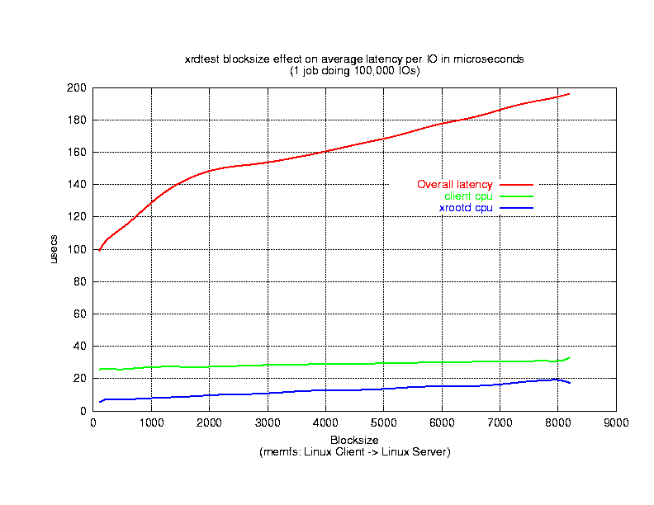
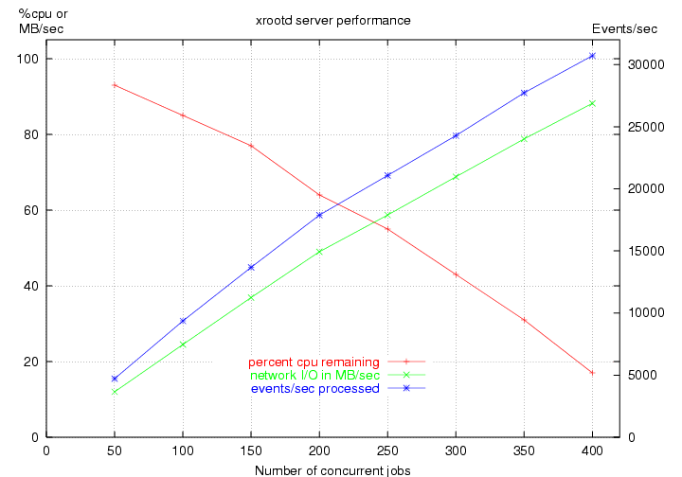
Performance II
Latency
Capacity vs. Load
Sun V20z 1.86 GHz dual Opteron 2GB RAM
1Gb on board Broadcom NIC (same subnet)
Linux RHEL3 2.4.21-2.7.8ELsmp
xrootd latency < 10µs → network or disk latency dominates
Practically, at least ≈100,000 Ops/Second with linear scaling
xrootd+cmsd latency (not shown) 350µs →»2000 opens/second

Slide 19
Performance & Bottlenecks
High performance + linear scaling
Makes client/server software virtually transparent
A 50% faster xrootd yields 3% overall improvement
Disk subsystem and network become determinants
This is actually excellent for planning and funding
Transparency makes other bottlenecks apparent
Hardware, Network, Filesystem, or Application
Requires deft trade-off between CPU & Storage resources
But, bottlenecks usually due to unruly applications
Such as ATLAS analysis
However

Slide 20
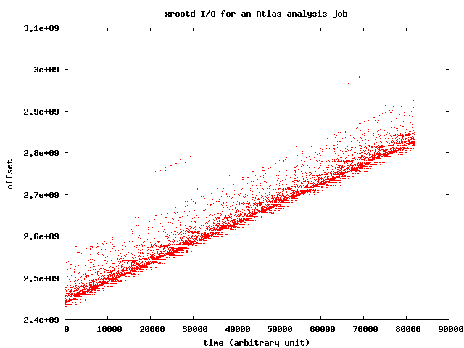
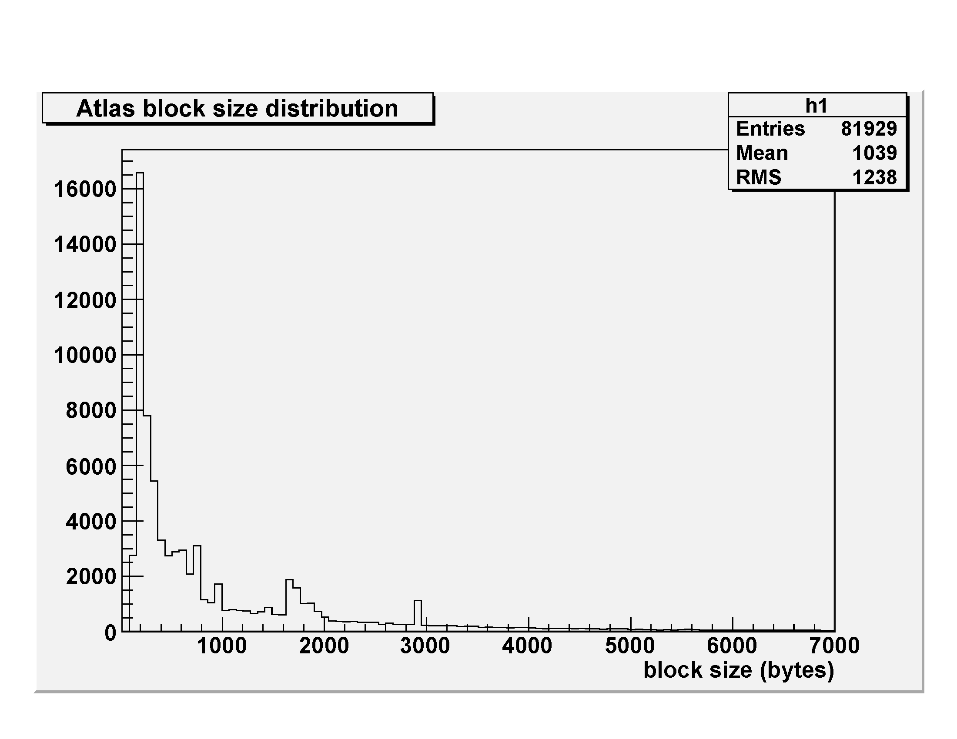
ATLAS Data Access Pattern

Slide 21
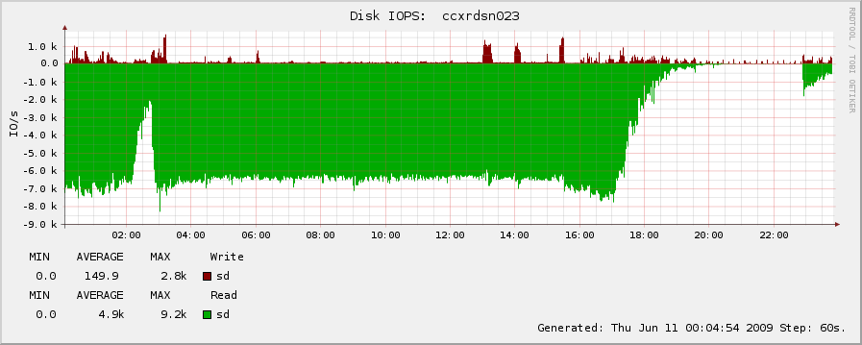
ATLAS Data Access Impact
Sun Fire 4540 2.3GHz dual 4core Opteron 32GB RAM
2x1Gb on board Broadcom NIC
SunOS 5.10 i86pc + ZFS
9 RAIDz vdevs each on 5/4 SATA III 500GB 7200rpm drives
350 Analysis jobs using simulated & cosmic data at IN2P3

Slide 22
ATLAS Data Access Problem
Atlas analysis is fundamentally indulgent
While xrootd can sustain the load the H/W & FS cannot
Replication?
Except for some files this is not a universal solution
The experiment is already disk space insufficient
Copy files to local node for analysis?
Inefficient, high impact, and may overload the LAN
Job will still run slowly and no better than local cheap disk
Faster hardware (e.g., SSD)?
This appears to be generally cost-prohibitive
That said, we are experimenting with smart SSD handling

Slide 23
Faster Scalla I/O (The SSD Option)
Latency only as good as the hardware (xrootd adds < 10µs latency)
Scalla component architecture fosters experimentation
Research on intelligently using SSD devices
Disk
ZFS Specific
ZFS caches disk blocks
via its ARC¹
Xrootd I/O:
Data sent from RAM/Flash
Data received sent to Disk
Flash
Disk
R/O Disk File Cache
Flash
FS Agnostic
Xrootd caches files
Xrootd I/O:
Data sent from RAM/Flash
Data received sent to Disk
Xrootd
Xrootd
R/O Disk Block Cache
¹Adaptive Replacement Cache
Will This Be Effective?

Slide 24
ZFS Disk Block Cache Setup
Sun X4540 Hardware
2x2.3GHz Qcore Opterons, 32GB RAM, 48x1TB 7200 RPM SATA
Standard Solaris with temporary update 8 patch
ZFS SSD cache not support until Update 8
I/O subsystem tuned for SSD
Exception: used 128K read block size
This avoided a ZFS performance limitation
Two FERMI/GLAST analysis job streams
First stream after reboot to seed ZFS L2ARC
Same stream re-run to obtain measurement

Slide 25
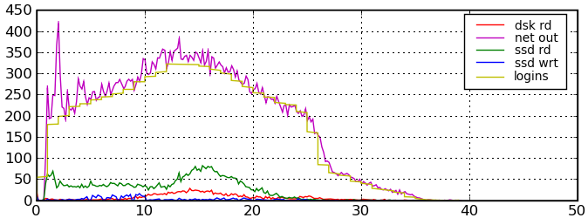
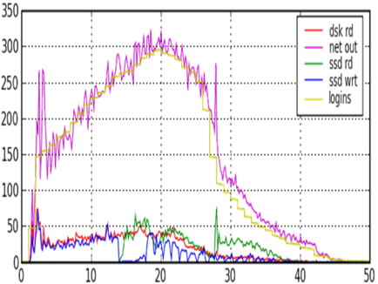
Disk vs SSD With 324 Clients
MB/s
ZFS R/O Disk Block Cache
Min
25% Improvement!
Cold SSD Cache I/O
Warm SSD Cache I/O

Slide 26
If Things Were So Simple!
ZFS Disk Block Cache is workflow sensitive
Test represents a specific workflow
Multiple job reruns (happens but …)
But we could not successfully test the obvious
Long term caching of conditions-type (i.e., hot) data
Not enough time and no proper job profile
Whole file caching is much less sensitive
At worst can pre-cache for a static workflow
However, even this can expose other problems

Slide 27
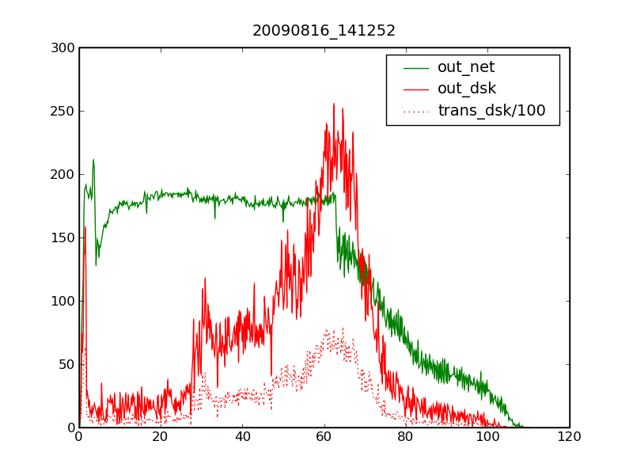
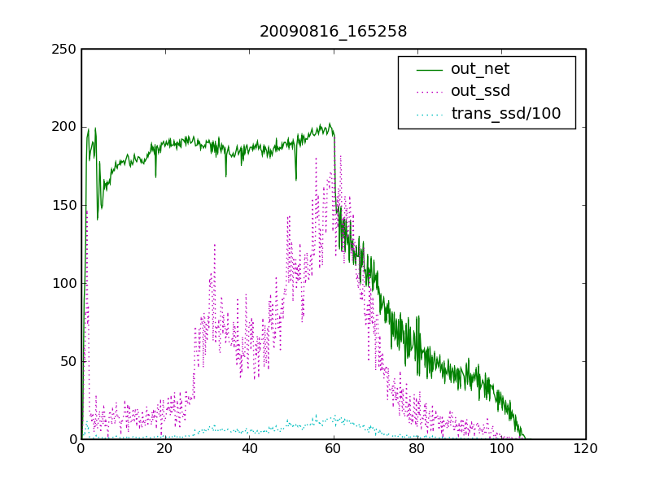
Same Job Stream: Disk vs SSD
MB/s
Xroot R/O Disk File Cache
Min
OpenSolaris CPU Bottleneck
OpenSolaris CPU Bottleneck
Disk I/O
SSD I/O

Slide 28
Xrootd R/O Disk File Cache
Well tuned disk can equal SSD Performance?
Yes, when number of well-behaved clients < small n
324 Fermi/GLAST clients probably not enough and
Hitting an OS bottleneck
OpenSolaris vectors all interrupts through a single CPU
Likely we could have done much better
System software issues proved to be a roadblock
This may be an near-term issue with SSD-type devices
Increasing load on high performance H/W
appears to reveal other software problems ….

Slide 29
What We Saw
High SSD load can trigger FS lethargy
ZFS + 8K blocks + high load = Sluggishness
Sun is aware of this problem
Testing SSD to scale is extremely difficult
True until underlying kernel issues resolved
This is probably the case irrespective of the OS
We suspect that current FS’s are attuned to high latency
So that I/O algorithms perform poorly with SSD’s

Slide 30
The Bottom Line
Decided against ZFS L2ARC approach (for now)
Too narrow
Need Solaris 10 Update 8 (likely late 4Q09)
Linux support requires ZFS adoption
Licensing issues stand in the way
Requires substantial tuning
Current algorithms optimized for small SSD’s
Assumes large hot/cold differential
Not the HEP analysis data access profile

Slide 31
The xrootd SSD Option
Currently architecting appropriate solution
Fast track → use the staging infrastructure
Whole files are cached
Hierarchy: SSD, Disk, Real MSS, Virtual MSS
Slow track → cache parts of files (i.e., most requested)
Can provide parallel mixed mode (SSD/Disk) access
Basic code already present
But needs to be expanded
First iteration will be fast track approach

Slide 32
Future Developments
Smart SSD file caching
Implement frm_purge
Needed for new-style XA partitions and SSD’s
Selectable client-side caching algorithms
Adapting Scalla for mySQL clusters
To be used for LSST and perhaps SciDB
Visit the web site for more information
http://xrootd.slac.stanford.edu/

Slide 33
Acknowledgements
Software Contributors
Alice: Derek Feichtinger
CERN: Fabrizio Furano , Andreas Peters
Fermi/GLAST: Tony Johnson (Java)
Root: Gerri Ganis, Beterand Bellenet, Fons Rademakers
SLAC: Tofigh Azemoon, Jacek Becla, Andrew Hanushevsky, Wilko Kroeger
LBNL: Alex Sim, Junmin Gu, Vijaya Natarajan (BeStMan team)
Operational Collaborators
BNL, CERN, FZK, IN2P3, RAL, SLAC, UVIC, UTA
Partial Funding
US Department of Energy
Contract DE-AC02-76SF00515 with Stanford University

