Slide 1
XROOTD Tutorial
Part 1
Introduction and basic concepts
Fabrizio Furano

Slide 2
Purpose
A basic tutorial for present and future sysadmins
Should be useful for other roles as well
Many many ideas around xrootd, we cannot cover everything, so we start from the beginning
Goals:
  Knowing what we are talking about
  Doing a couple of exercises
  Being able to face the effort of setting up a cluster
  Being able to solve problems – support people

Slide 3
Outline
What’s that?
The original distribution (vanilla xrootd)
  What/where is it, how to do simple things with it
  Exercise: setting up a personal data server (1hr)
The bundles
  Philosophy
  Let’s take one
  What does it do in general
  Exercise: setting up our cluster (1 hr)
  Exercise: doing something with it (30min)
Conclusion and other directions
  E.g. vMSS, SRM compliance

Slide 4
Xrd for dummies
A plugin loader, whose default set of plugins does…
…storage aggregation (disks/machines/sites)
  Aggregating means hiding the distribution through an unique entry point
High performance data access through a specialized client
Smart design, modern protocols, timeouts, “infinite” scalability, fault tolerance, …
NO databases, the file systems already know enough about their content
Fully plugin based
  All the hooks that are needed by serious app developers
Alone it does basic things
  The power comes from the configurability and the adaptability to HEP and HPC requirements

Slide 5
xrootd Plugin Architecture
authentication
(gsi, krb5, etc)
Protocol Driver
(XRD)
Protocol (1 of n)
(xrootd, xproofd etc.)
lfn2pfn
prefix encoding
Authorization
(default, alice, etc)
File System
(ofs, sfs, alice, etc)
Storage System
(oss, drm/srm, etc)
Clustering
(cmsd)

Slide 6
How does it work (1/2)
A single server aggregates mountpoints
Mount points, i.e.
FAST local storage
(although fragmented)
/dataX
xrootd
Client
/dataY
/dataZ
EXPORT an unique name space, e.g.
/mydata/a/b/c
There’s no trace of the mountpoints here
/data..

Slide 7

How does it work (2/2)
A redirector aggregates up to 64 servers
  (Many redirectors, called supervisors) can aggregate up to 200K servers)
Client
xrootd
A small
2-level cluster.
Can hold
Up to 64 servers
cmsd
P2P-like
xrootd
xrootd
xrootd
cmsd
cmsd
cmsd

Slide 8
TCP daemons
These are all high performance TCP servers, living in one port each (normally)
    1094/TCP – Standard data access port. This must be visible to the applications/users, eventually from outside the site
    All the servers must be reachable by the apps
    All the servers must be configured as… uhm… servers!
      Max available number of file descriptors is often server-unfriendly
        Thousands of clients per server can happen often
      If more clients need to be accommodated → problems/OS choppiness
    The port related to the internal clustering protocol is less important. Applications/users do not use it. A common port for this is 3122/TCP

Slide 9
Name translation
LFN = Logical File Name
  It’s the filename in the EXPORTED namespace
  As it is read/written by the applications
PFN = Physical File Name
  It’s the INTERNAL filename
  The file as it is stored in the mountpoints
  NOT visible by the applications, they don’t need.
  Only the sysadmin knows it

Slide 10
LFN<->PFN mapping (1/2)
Simple and fast, just a string mapping
Please remember that the apps DO NOT SEE this
Let’s suppose that we have only one mountpoint /mnt/data1 :
    PFN = <prefix>/LFN
    E.g. /mydata/myfile.dat → /mnt/data1/mydata/myfile.dat
The string <prefix> is called LOCALROOT
  It usually is a mountpoint with an additional directory

Slide 11
LFN<->PFN mapping (2/2)
LOCALROOT is one of the best friends of security
It means that no application has access to any directory in the machine that does not begin with this prefix
In other words: every data file stored will have a private path starting with it
  So you know where the stuff goes
  And that nobody will mess up with it

Slide 12
Mountpoints for data
ALWAYS store your data in a SUBDIRECTORY
  It’s easier to rename/move/maintain
  Like: /mnt/data01/xrddata
    /mnt/data01 IS A VERY BAD CHOICE
    /home/xrootd IS EVEN WORSE
In case of hw replacements/failures these are your best friends, KEEP THEM SIMPLE AND PRACTICAL
The user running the xrootd daemon must have rwx access to them (possibly own them)

Slide 13
Aggregating mountpoints
We aggregate several mountpoints into one server by giving to the xrootd daemon one more information
  Yes, the list of the dirs to aggregate, what else? ☺
  This is called “Cache File System”
When given this information, a server will slightly change the way it places files around
  LOCALROOT will still hold the filenames, but they are symlinks in this case
  The various dirs hold the data files, with the names slightly modified (but still recognizable)
  In practice LOCALROOT hosts the “catalogue”, or, better, the “namespace”
    And it can always be reconstructed in case of disasters

Slide 14
Aggregating mountpoints
Again: DO NOT PUT DATA STRAIGHT INTO MOUNTPOINTS
  Create a directory into each of them. In the case of the cache filesystem something like:
    <mntpoint>/xrddata
  A good name for the localroot one is
    <mntpoint>/xrdnamespace
  Of course, one of the mountpoints will contain BOTH the localroot (which acts as a namespace) AND one dir of data

Slide 15
The root user (1/2)
Simple rule (the same as Apache): an xrootd/cmsd daemon REFUSES TO START AS ROOT.
So, you always need a proper user for it to run (most people use ‘xrootd’)
It MUST have rwx access to the data mountpoints, ev. owning them
In theory it does not need a $HOME, in practice, in the more sophisticated setups there’s always some plugin that needs it.
  Hence, for us it’s as if it’s needed. Let’s do it.

Slide 16
The root user (2/2)
In practice:
  Root is used only to setup the machine, create partitions/mountpoints etc.
  The setup of the vanilla package can be anywhere, including problematic places like /usr/bin/xrootd or /opt/xrootd or /usr/bin etc.
  The setup of the more sophisticated bundles is done generally in /home/xrootd
    Some sysadmins stick to /usr or /opt or love to put everything into an RPM package.
  The setup and the HOME must be in a LOCAL DRIVE, so everything works also if the machine is temporarily disconnected

Slide 17
The server machine
It MUST always work, hence:
  Avoid dependencies to useless things
    E.g. AFS/NFS homes… NO! $HOME must be a local and separated partition, different from the one hosting the data
    This aids sleep…
In general, it must be able to survive arbitrarily long network disconnections
  Once reconnected it has to work without intervention
  One of the consequences of the xrootd fault tolerance mechanism is that the traffic may come almost immediately after the reconnection
Every relaxation of these is in the responsibility of the sysadmin
  Being called by night is generally not funny

Slide 18
Where to get it
Let’s stick to the vanilla tarball for the moment
2 places:
  The original repo at SLAC
      http://xrootd.slac.stanford.edu/
  The Savannah repo at CERN
      https://savannah.cern.ch/projects/xrootd

Slide 19
Pre-requirements
A working development environment (g++, libs, etc.)
  Yum gcc, gcc-c++, zlib-devel
The servers don’t need anything special to compile
Some plugins do!
  E.g. Kerberos, X509 etc…
The configure.classic script disables everything for which the requirements are not met
  For the moment we want just to do an exercise, we don’t need strange things (we will)
Locate the latest stable tarball in the website(s)

Slide 20
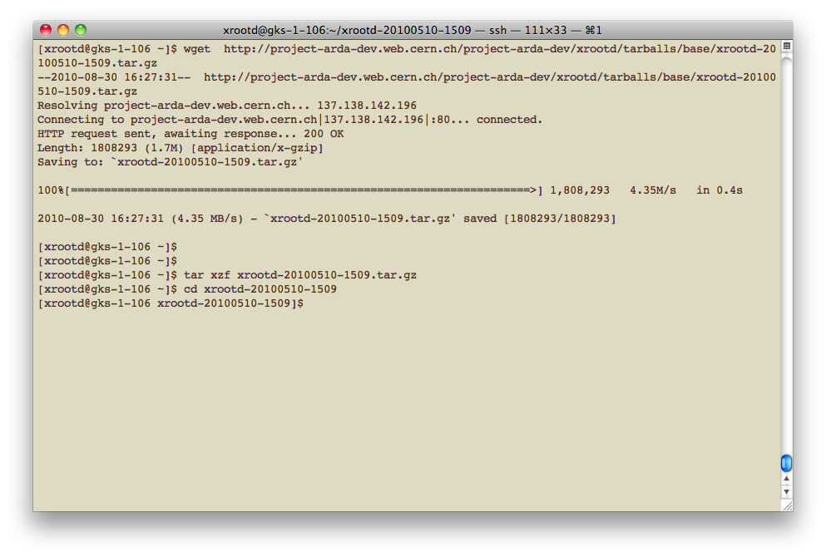
Download and unpack

Slide 21
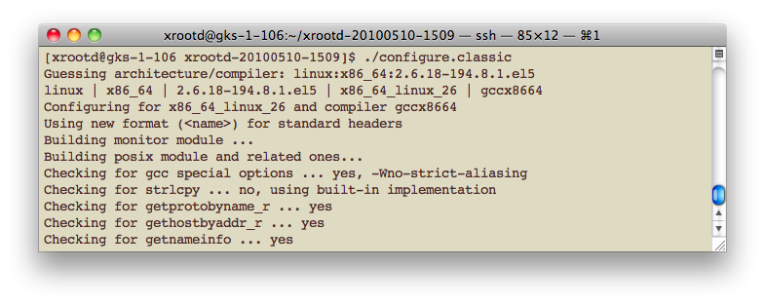
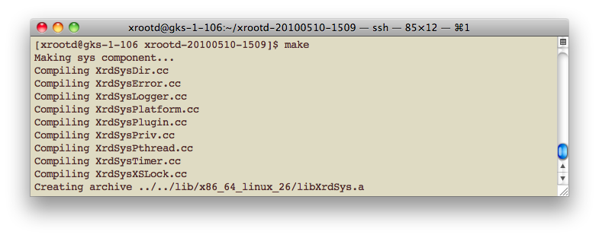
Configure/Compile it

Slide 22
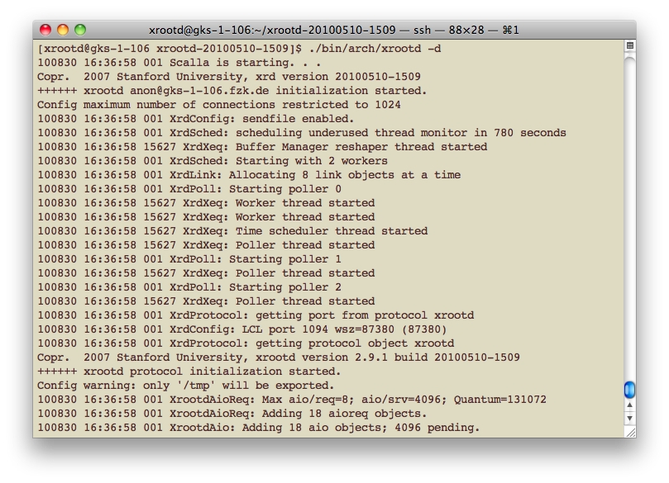
Start it manually
Let’s start our personal server: xrootd [–d]

Slide 23
It’s already working
As a single, non clusterized server
By default:
  It exports /tmp
  No LFN/PFN translation (identity function)
  Prints the log to stdout
  With –d we started it in DEBUG mode, so it’s quite verbose
Familiarize with the log

Slide 24
URL format
root://HOST/ABSOLUTEPATH
HOST → host1[,host2,…hostN][:port]
  A random host is chosen if there are alternatives
  Each hostname can be DNS-aliased
    NB this is not DNS round-robin
ABSOLUTEPATH is an absolute path, hence it starts with ‘/’
  Hence, an URL looks like:
  root://myhost//mypath/myfile

Slide 25
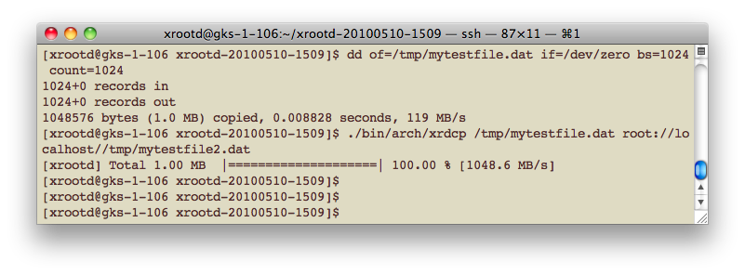
Xrdcp
It’s the xrootd data copy app
Basic usage: xrdcp <source> <dest>
  Where <src> and <dest> can be:
    Local pathnames e.g. /home/furano/mydata.txt
    Root: URLS, e.g. root://host//mydata.txt

Slide 26
Xrdcp – the basics
It’s a data copy program, with several features
  The easiest way to test a new server/cluster, just read/write into it and then check manually the presence of the files

Slide 27
The config file [xrootd.cf]
Right now we just had a simple personal server. Good to play with, useless in a serious site…
  We need to configure it, clusterize etc.
The syntax is described in the docs in the website
  Let’s have a quick look
TONS of options may be specified, to accommodate the weirdest requirements
Let’s start from the very basic ones:
  export : Allows a directory prefix to be exported (by default only /tmp is exported)
  oss.localroot : Configure the LFN<->PFN translation
  oss.cache : Specify mountpoints to aggregate

Slide 28
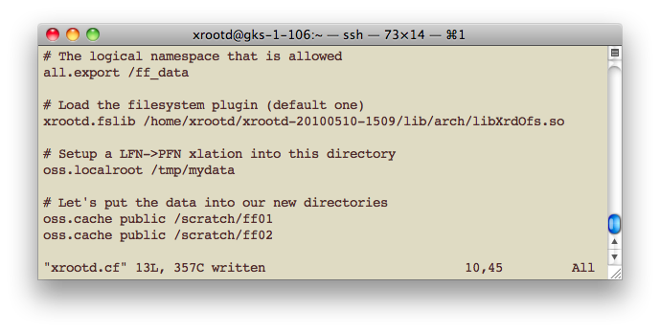
Localroot, PFN, LFN

Slide 29
The cache file system
Ugly historical name, actually it’s not a cache at all(!)
It’s the mechanism used to aggregate partitions
    The true file name is put as a symlink into the LOCALROOT
    The data file (slightly renamed) is put into the appropriate data partition
    The link points to the data file

Slide 30
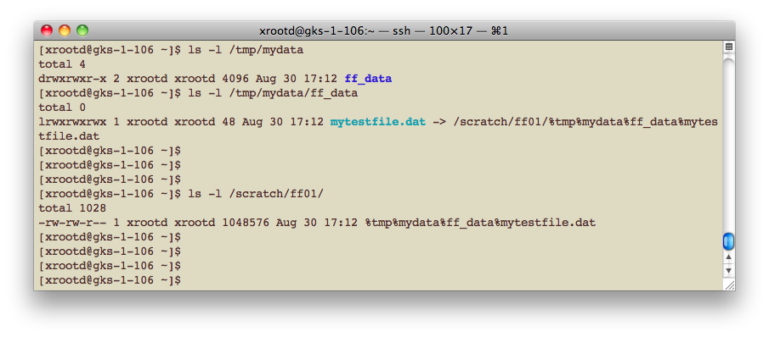
Using partitions [oss.cache]

Slide 31
The ‘xrd’ command line (1/3)
An UI that gathers together all the functionalities that are not related to data read/write, e.g.
  Stat: gives info about a file (size, date etc.)
  Locatesingle: find the first replica of a file in the cluster (used by PROOF to optimize its scheduling)
  Locateall: find all the replicas of a file
  Dirlist: list the content of a directory
  Rm: try to guess…
  The easiest thing to do is starting it and request ‘help’

Slide 32
The ‘xrd’ command line (2/4)
A true example. Enabling the debug mode we discover why a data server seems broken from outside
In practice we are not able to connect because the firewall is closed

Slide 33
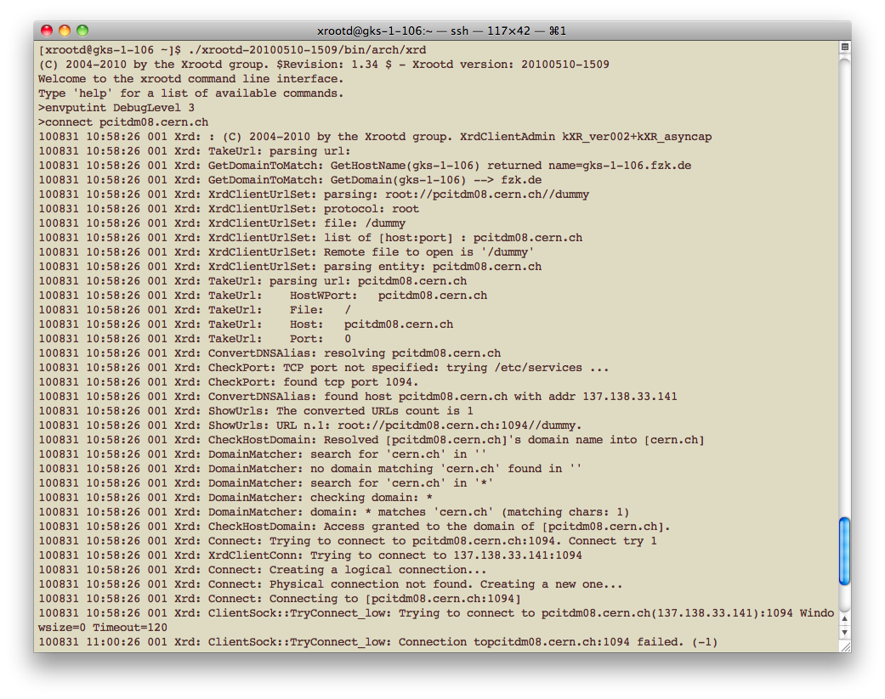
The ‘xrd’ command line (3/4)

Slide 34
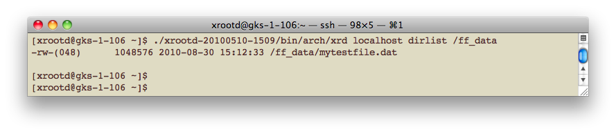
The ‘xrd’ command line (4/4)
We can use it in scripts
Just put the command+args in the command line:
xrd host[:port] cmd arg1 arg2 … argN

Slide 35
Directories and exports
It may seem philosophical, but ‘pure’ xrootd handles directories in a funny way
  Remember: everything was designed to optimize the frequent case, i.e. open/read/write
  A directory in practice is not quite an entity
  It’s more similar to a string that prefixes a filename
  This means that the ‘xrd’ command line does its best to FAKE a directory structure that may not exist exactly in that form

Slide 36
Basic clustering
Cmsd daemons clusterize into a tree-shaped network
Xrootd daemons talk to their cmsd counterpart
Redirector machine
  Manager
  Supervisor
  Meta-manager
Data server machine

Slide 37
How clusters work
Dynamic subscription, p2p-like protocol, no static lists
Servers are given the name of the redirector that administrates their cell (max 64)
  Redirectors may be managers or supervisors (=sub-managers) to create huge clusters
The protocol can pause/redirect clients explicitly and gracefully

Slide 38
How clusters work
A
open file X
Redirectors
Cache file
location
2nd open X
go to C
Who has file X?
B
go to C
open file X
I have
C
Client
Redirector
(Head Node)
Data Servers
Cluster

Slide 39
A word about security
Plugins are trivial to load, that’s not the big deal
  XrdSec already has a good number of them, covering most of the cases (SSS, krb4/5, X509, UNIX, ALICE tokens…)
Less trivial is to configure them and match their protocol’s infrastructure
  That’s not really xrootd stuff

Slide 40
Authentication/Authorization
Xrootd splits them off completely
  XrdSec plugins
    How to authenticate a client
  XrdAcc plugins
    What to do with the authenticated client, apply permissions, etc
In this tutorial we don’t have time to deal with that. It’s worth more than a tutorial only for security.
  BUT… in HEP there are common practices and standard configurations
    Often common things in the same group/experiment

Slide 41
An exercise (1h30’)
Download the source tarball, compile it and start it in single server mode.
Configure a private single server exporting the namespace “/mydata”
The data namespace must be stored in the dir /scratch/<your_name>/xrdnamespace
  And the data files into
    /scratch/<your_name>/data1/
    /scratch/<your_name>/data2
Write a 10MB data file with LFN /mydata/<yourname> using xrdcp
Read it back to /dev/null, with xrdcp
Verify (as a sysadmin) the correctness of the symlink and of the data file

